Slide 1
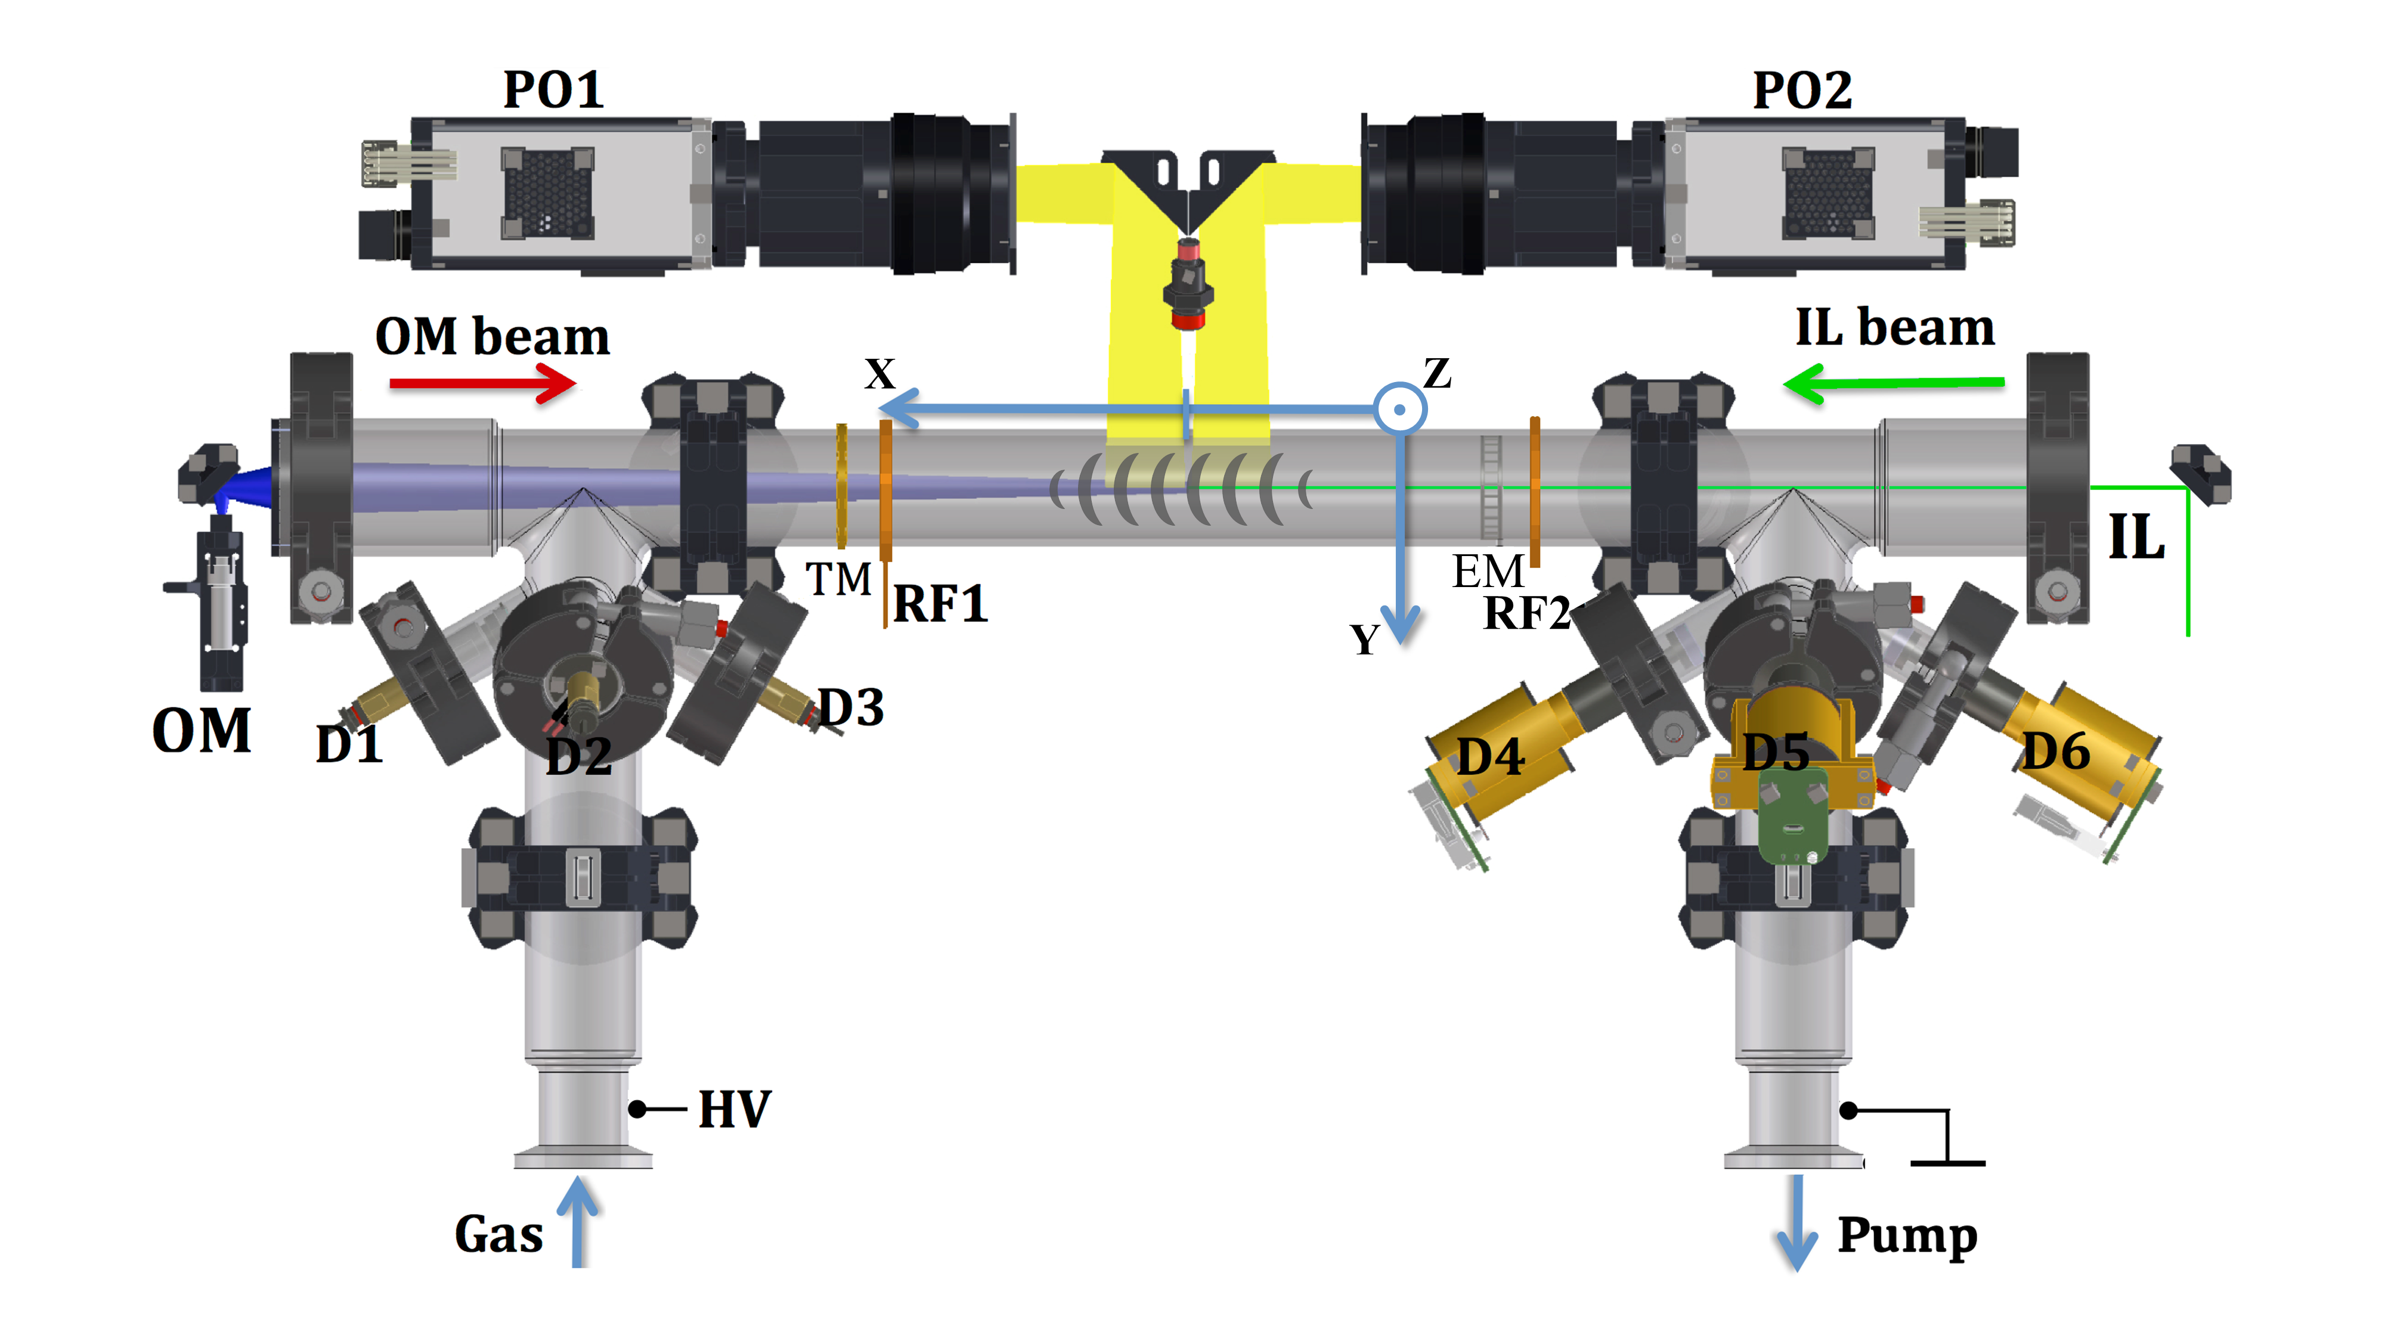
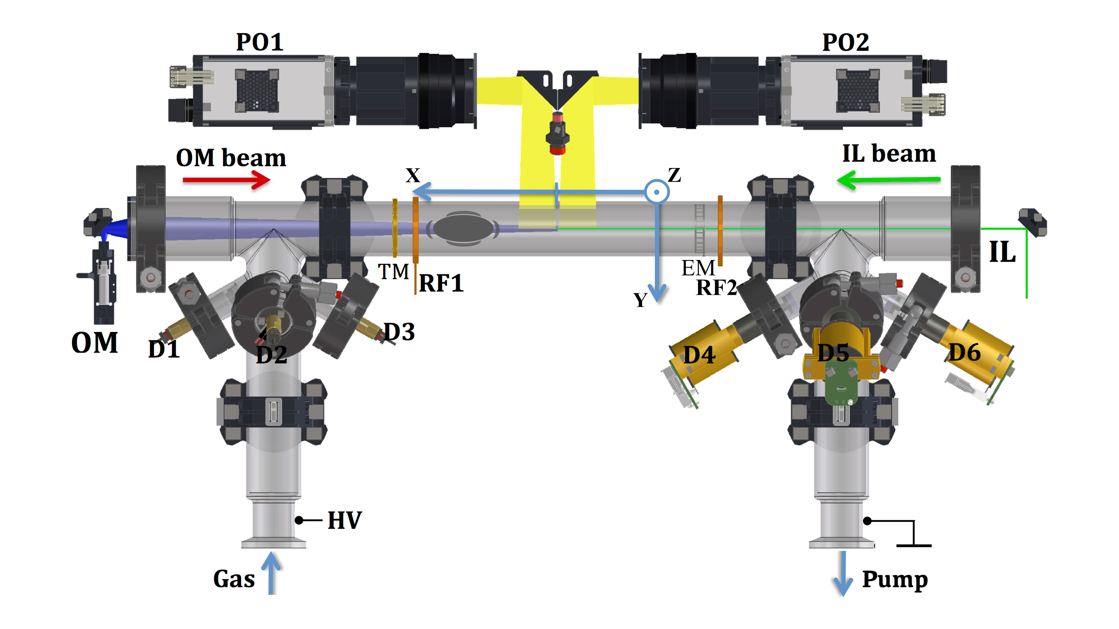

Introduction
1.
1b.
2.
2b.
Forward (F)
Backward (B)
I = - 0.5 mA
I = 0.5 mA

Slide 2
Introduction
V_group
Forward (F)
Backward (B)
I = - 0.5 mA
I = 0.5 mA

Slide 3
Introduction
C_daw = v_group – v_phase_measured
V_group
Forward (F)
Backward (B)
I = - 0.5 mA
I = 0.5 mA

Slide 4
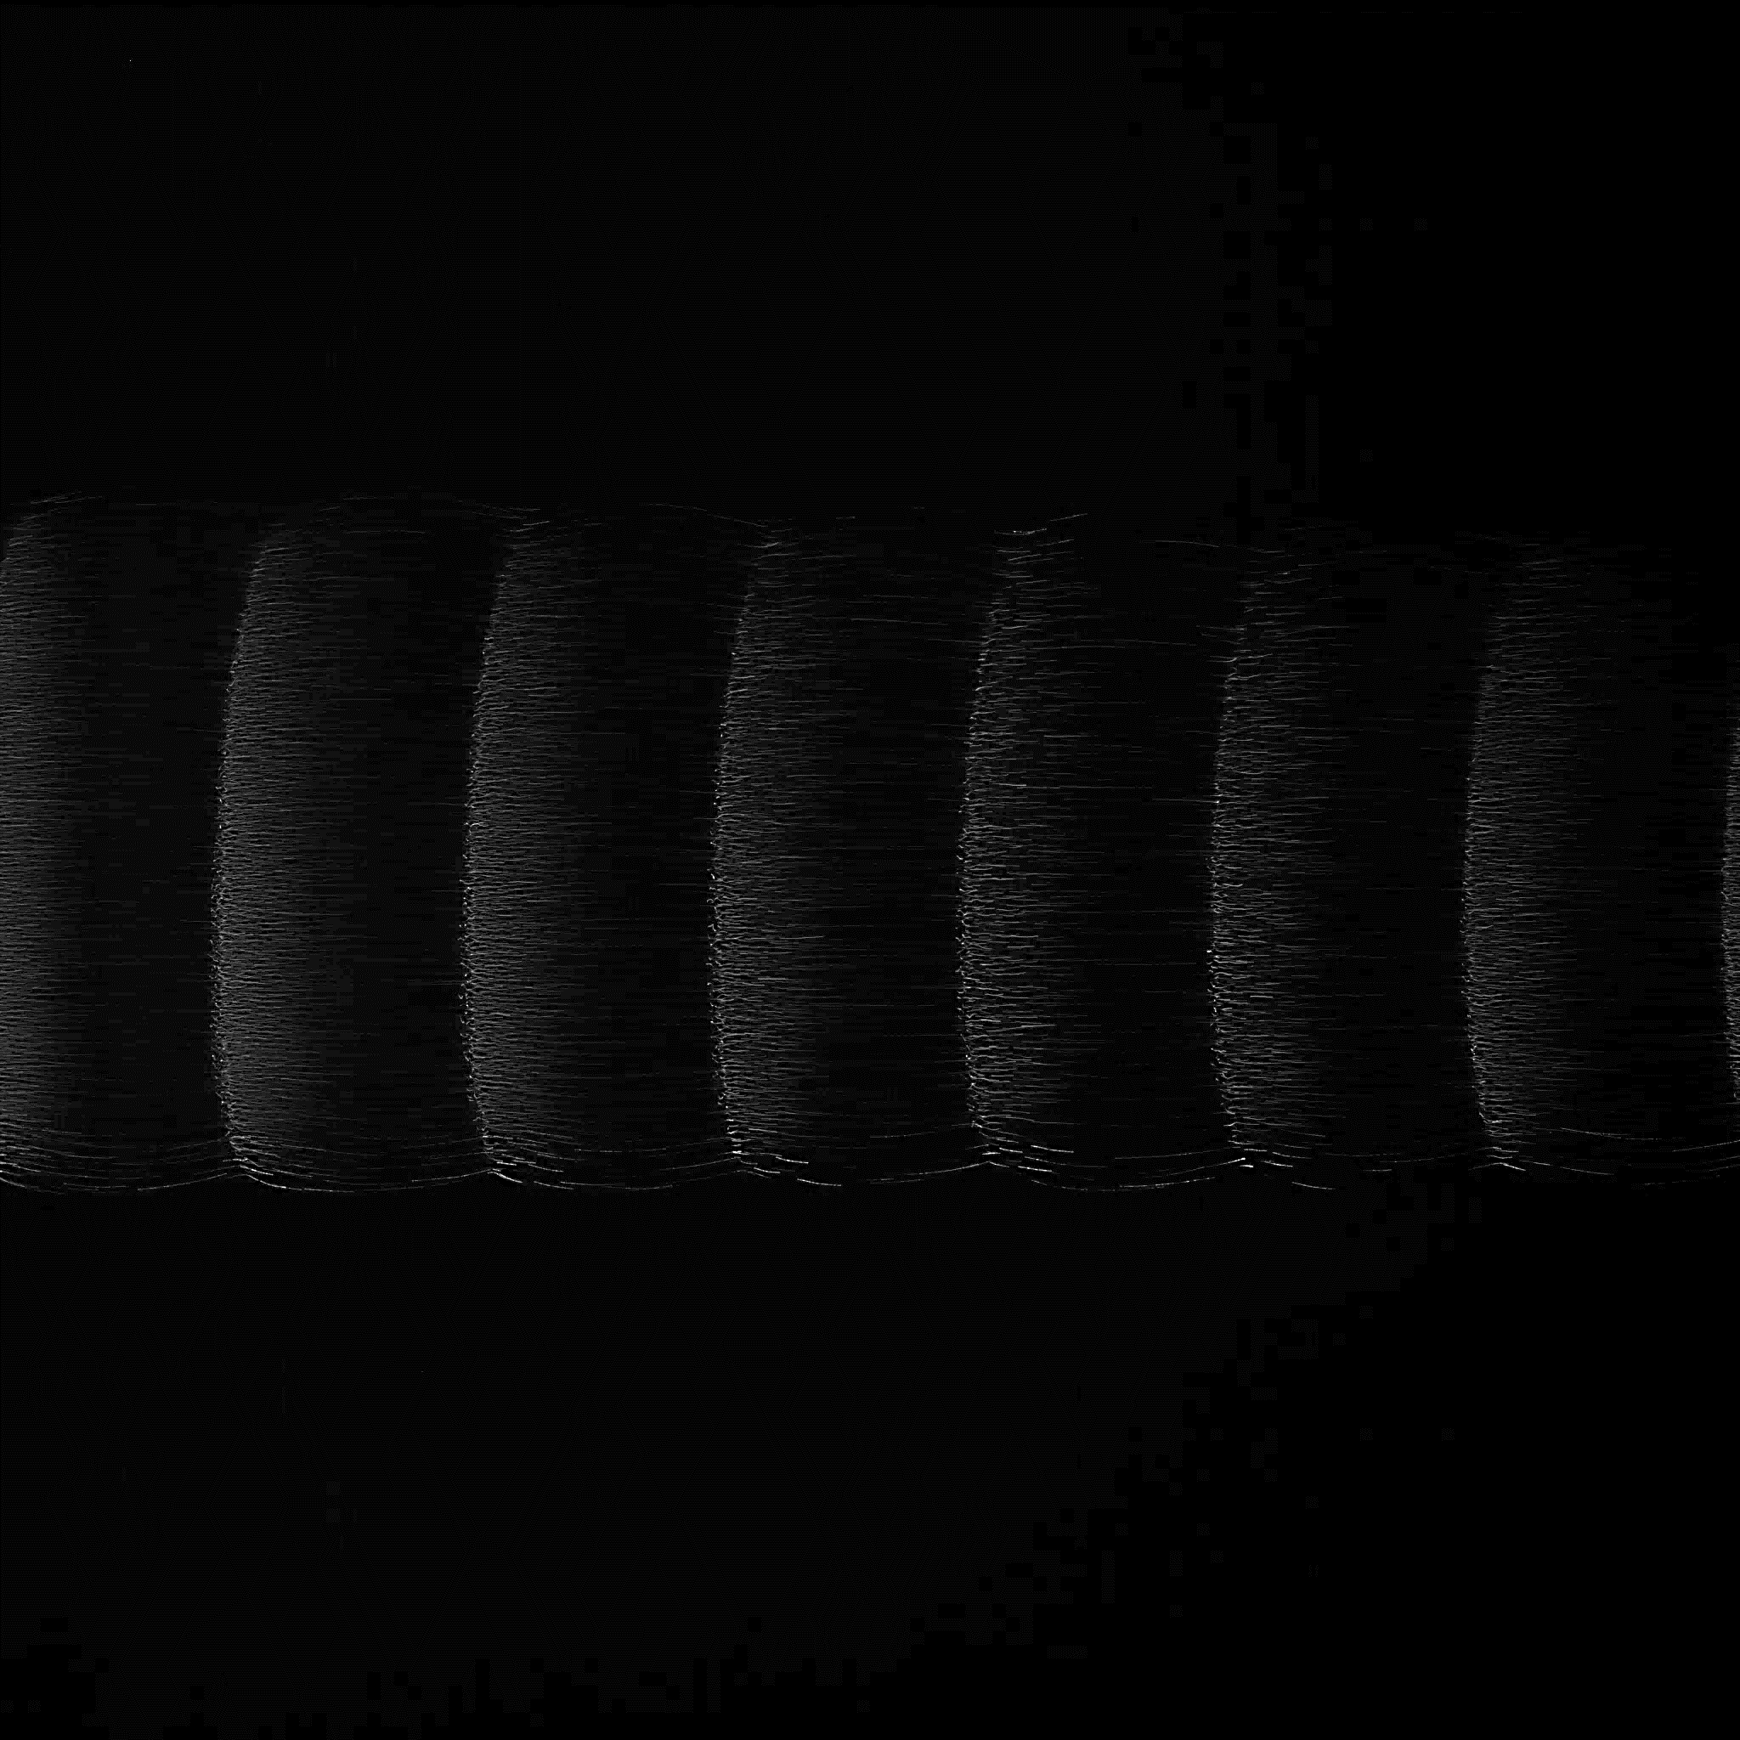
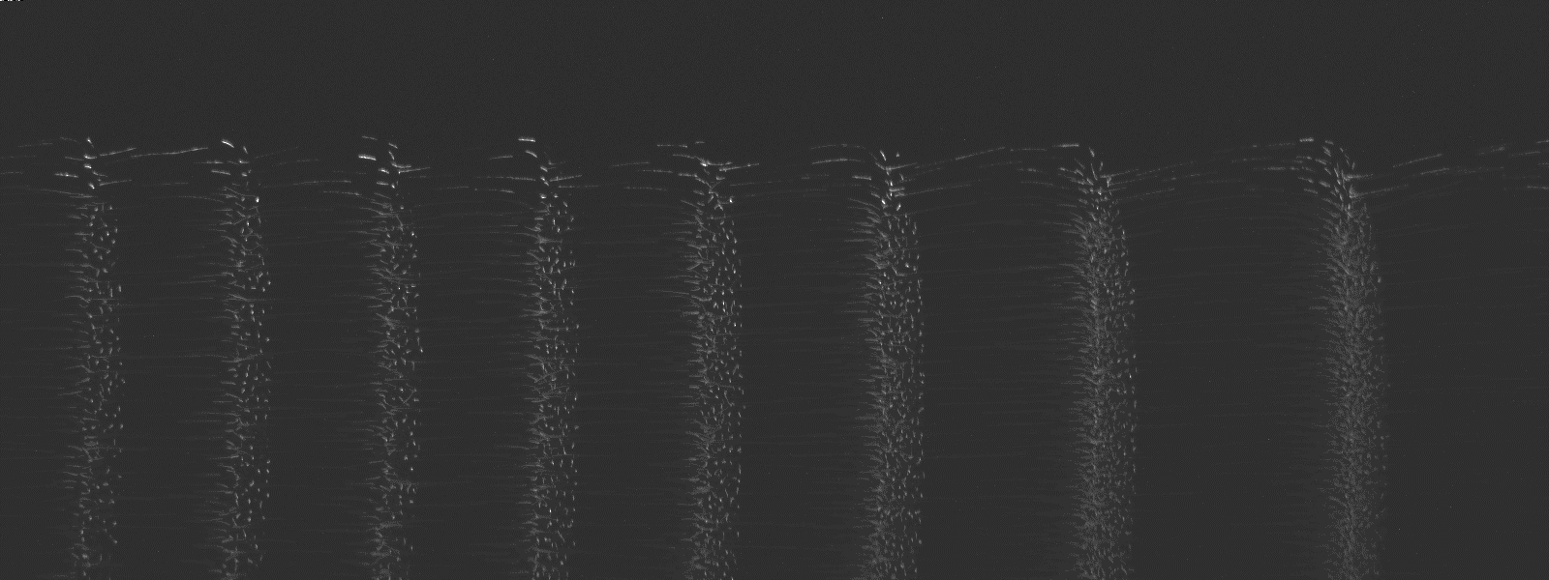
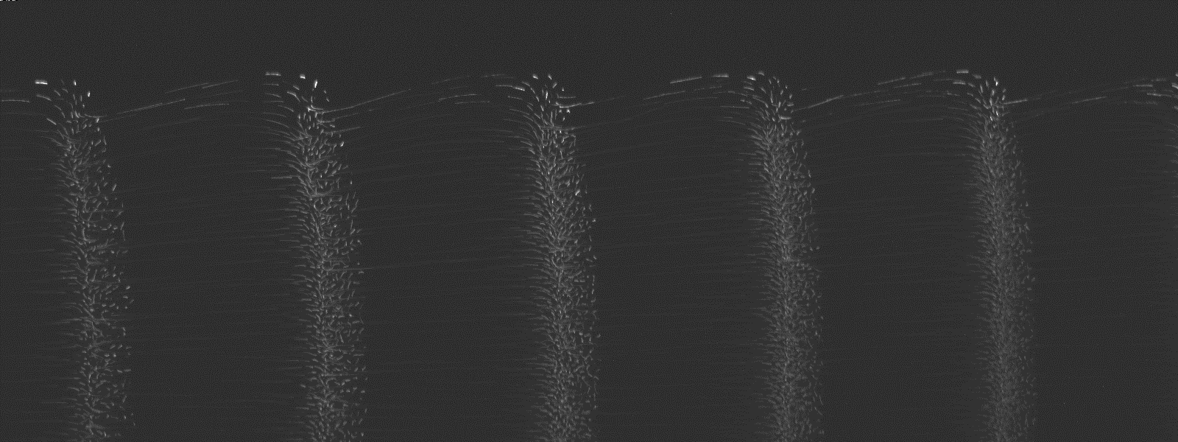
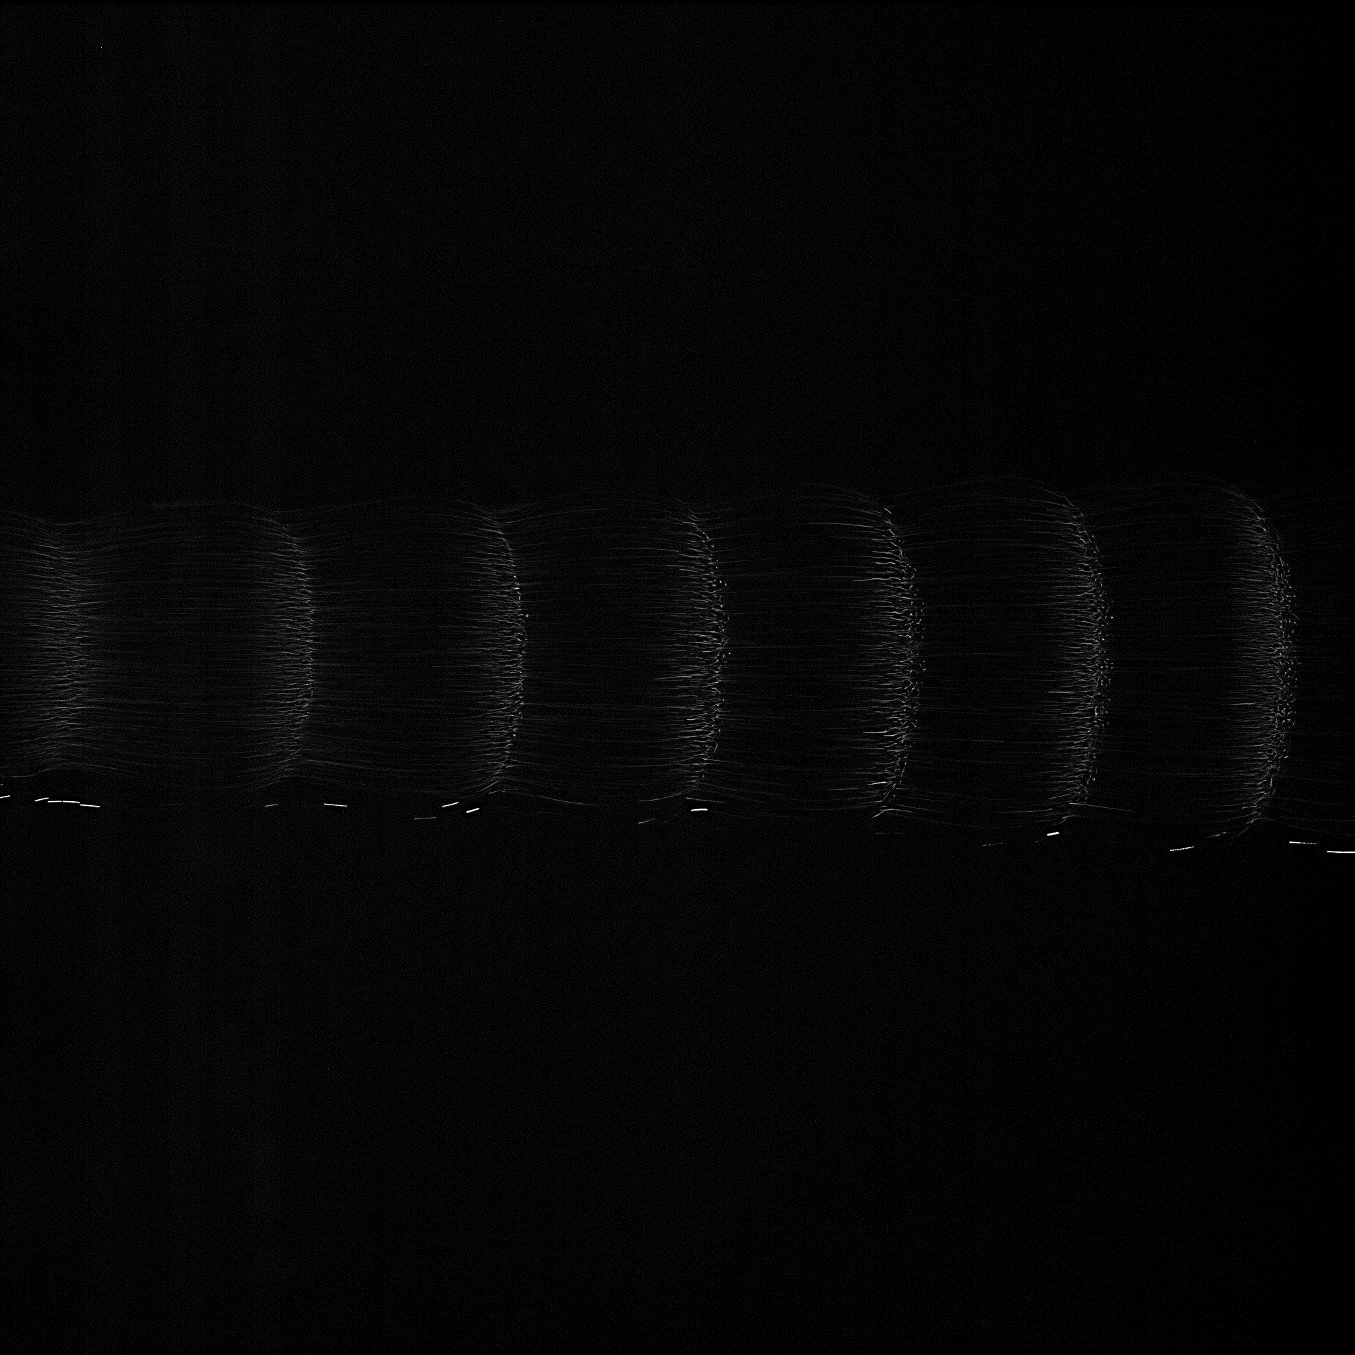
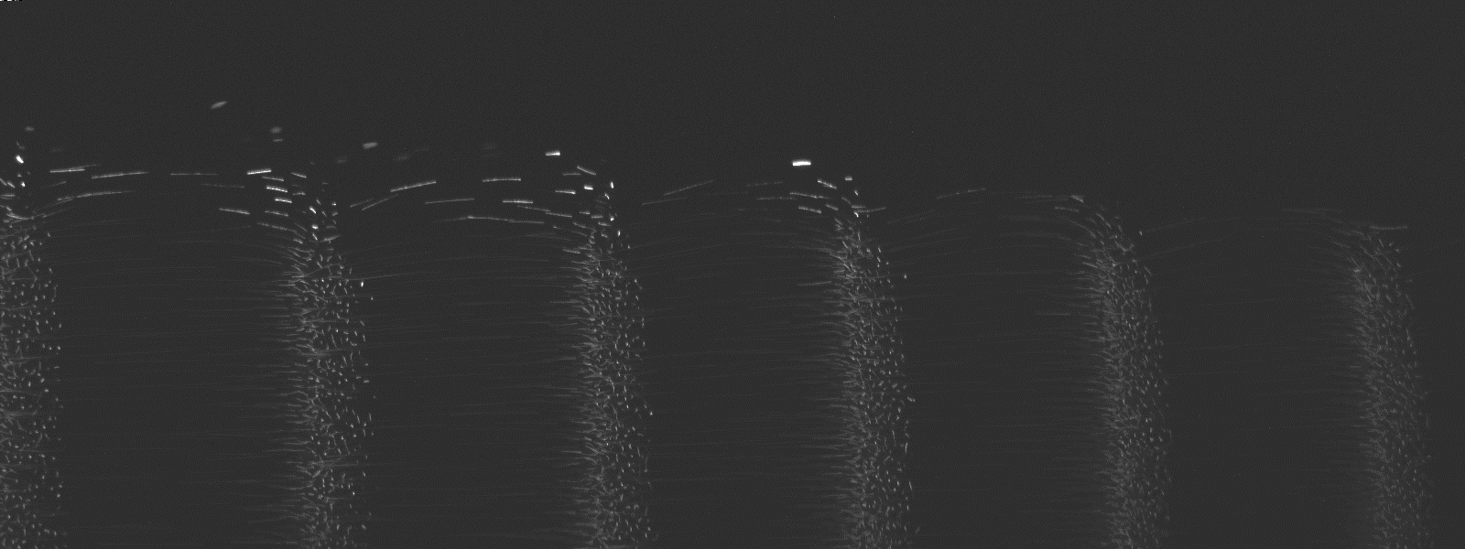
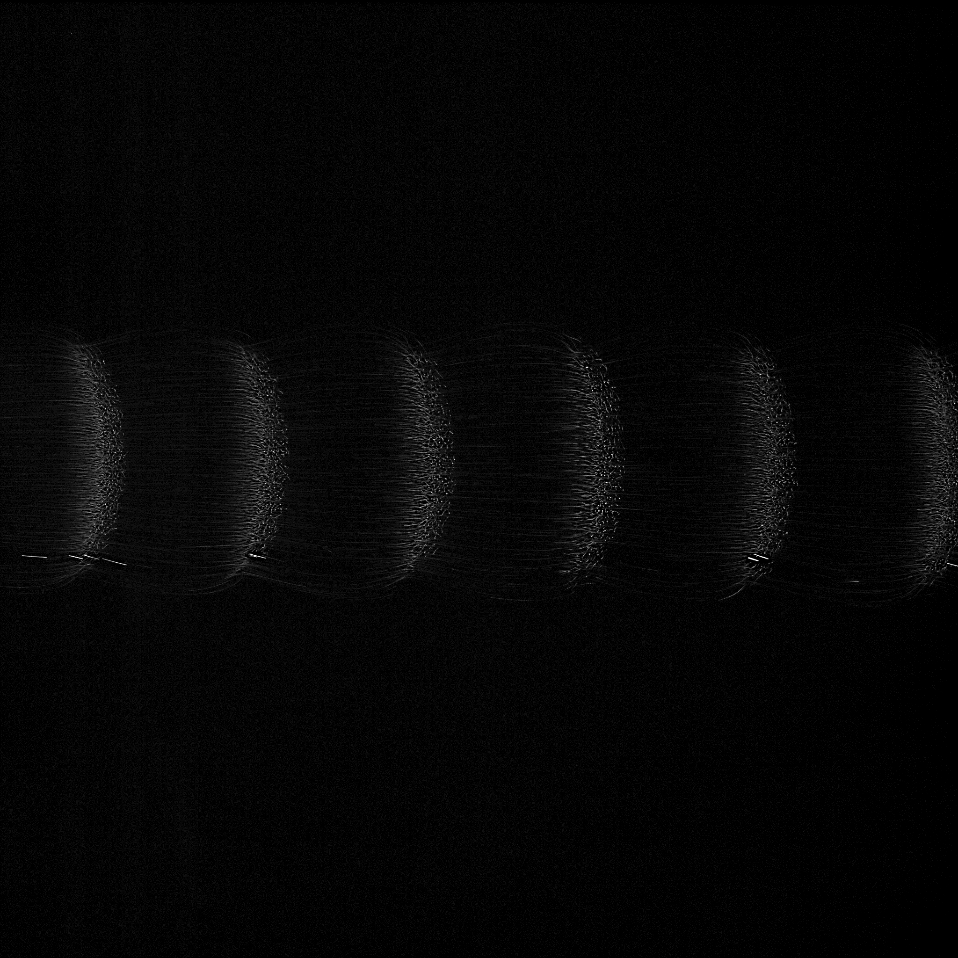
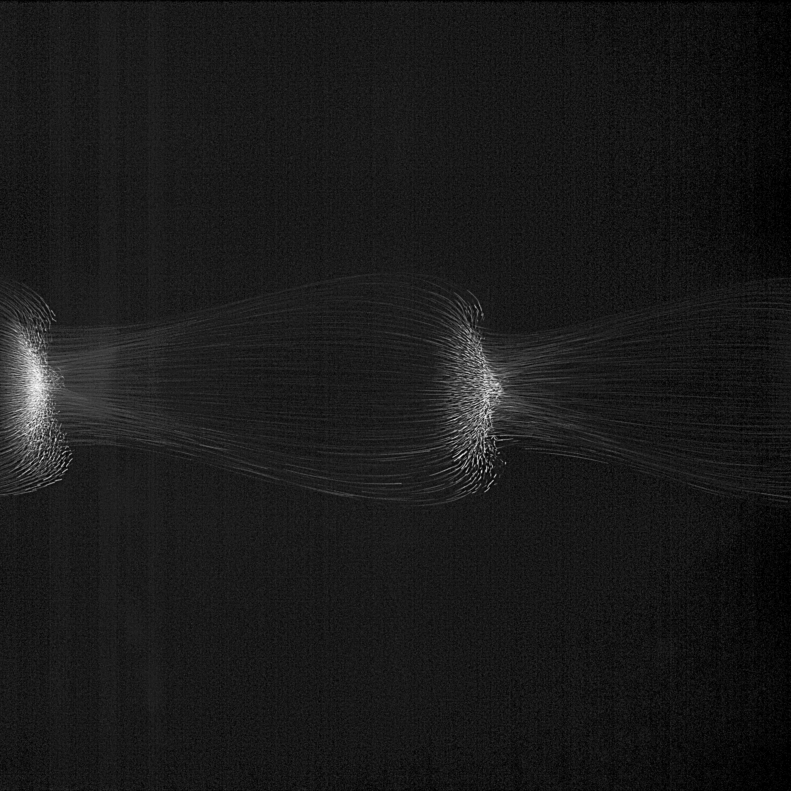
2 mm
PFC
40 Pa
2 mm
ISS
30 Pa
25 Pa
20 Pa
15 Pa

Slide 5
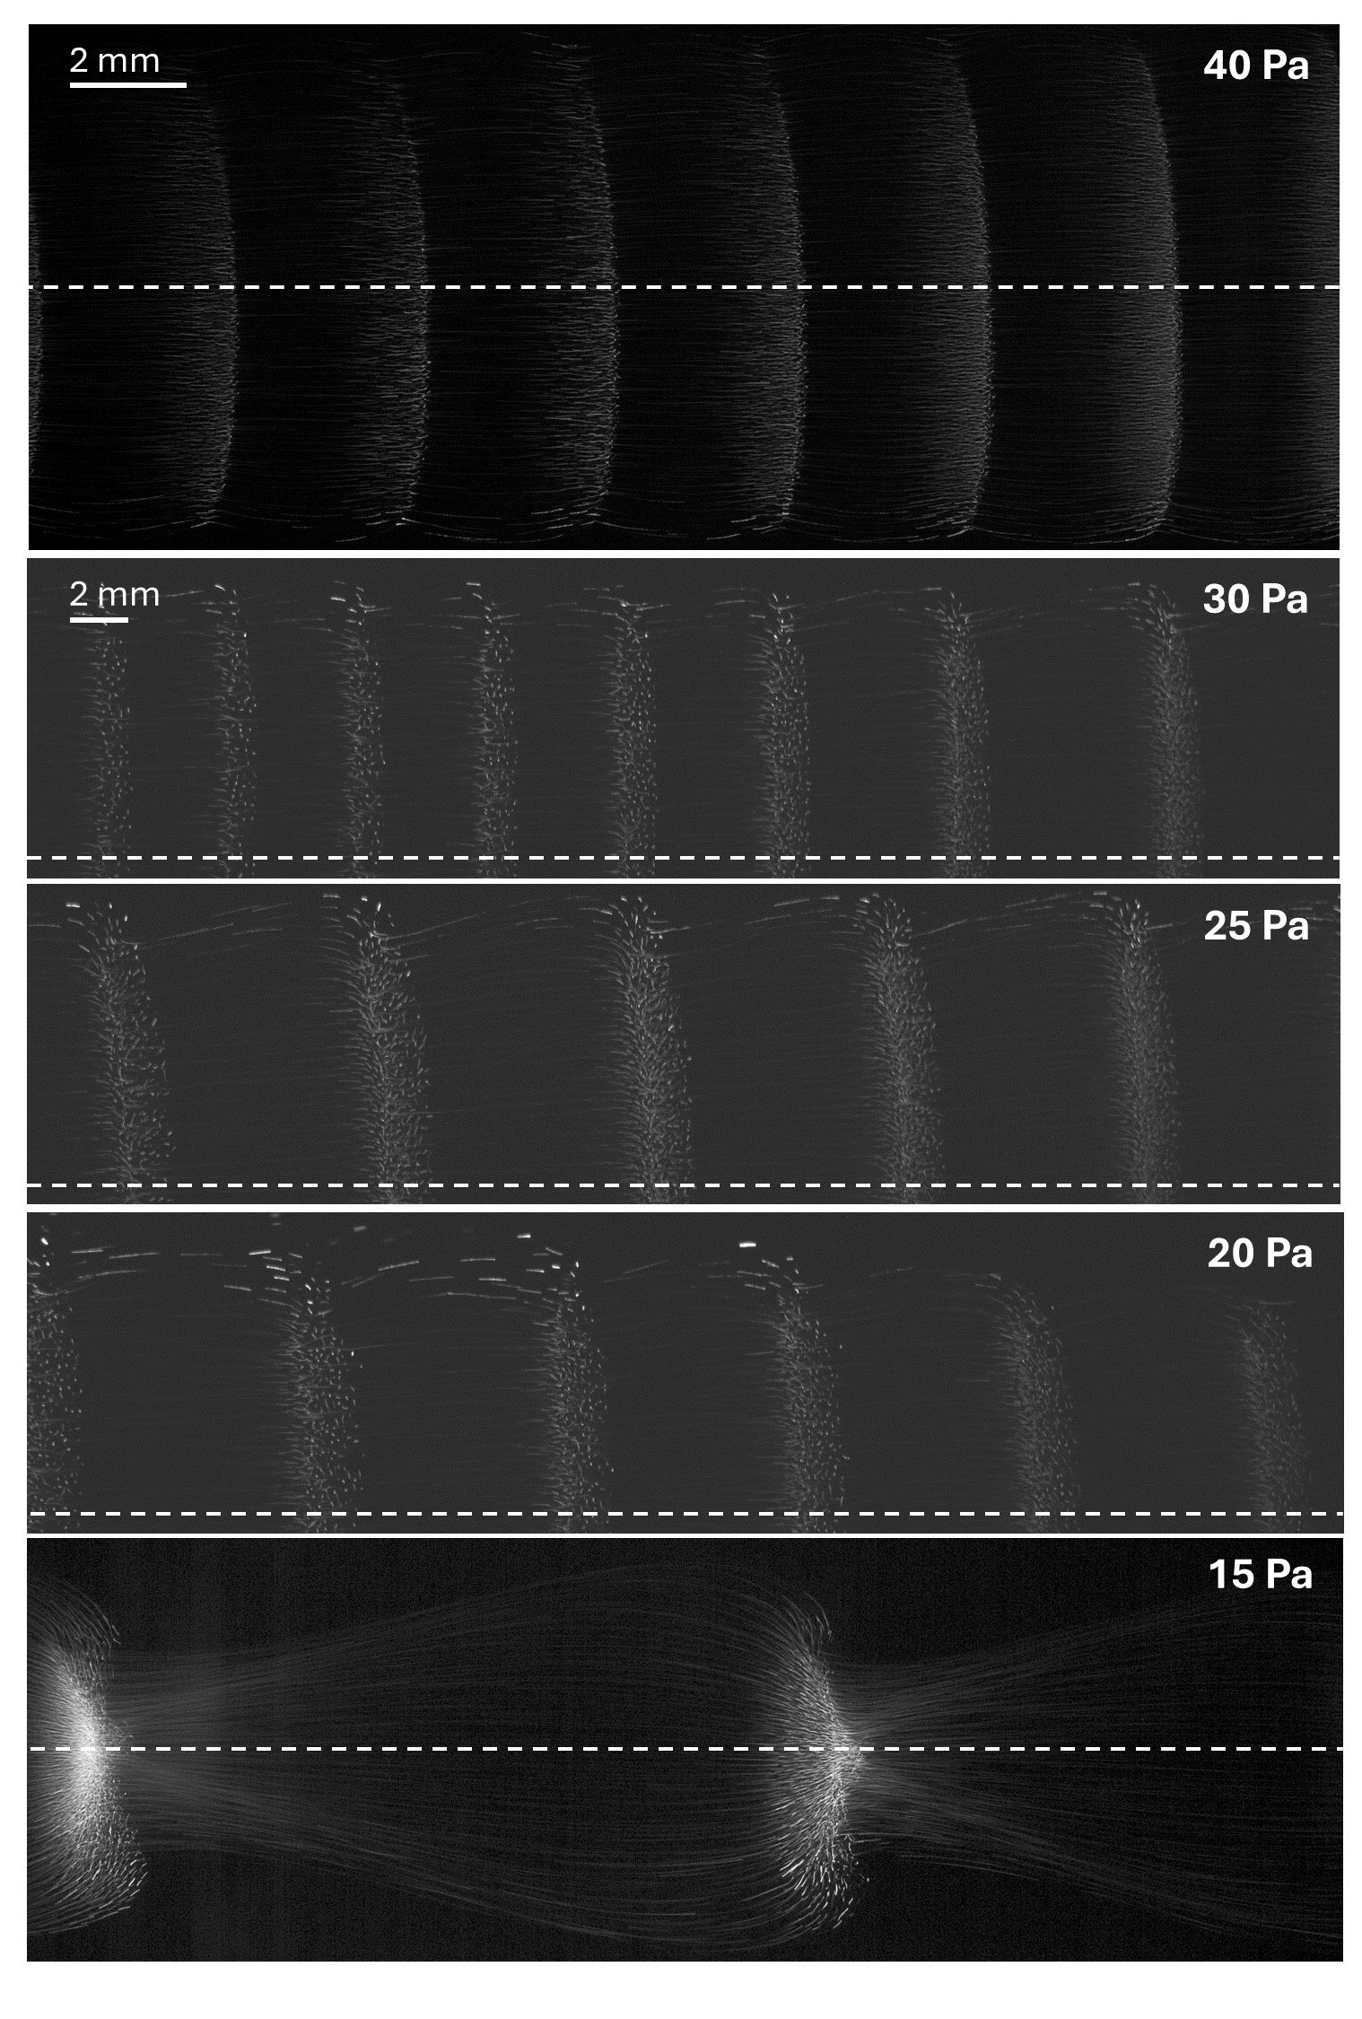
PFC
ISS

Slide 6
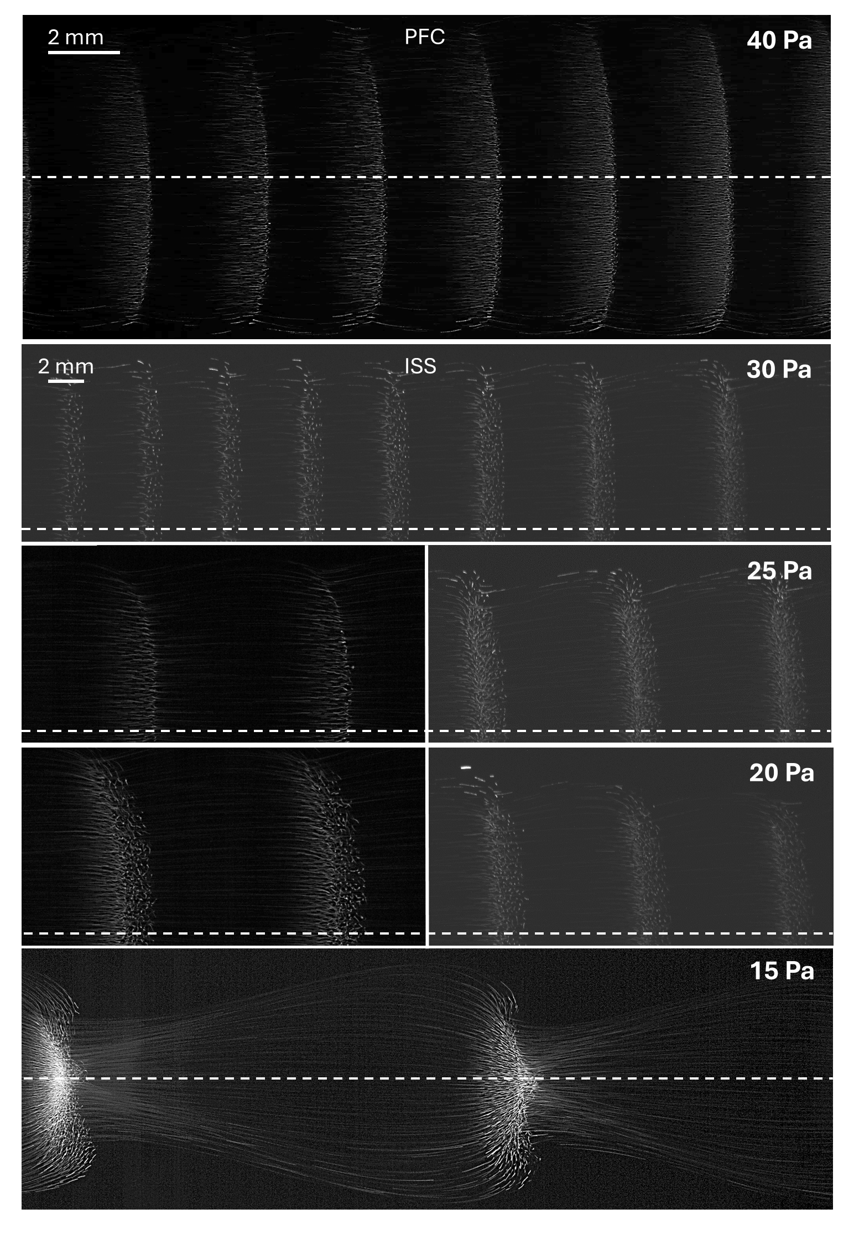

Slide 7


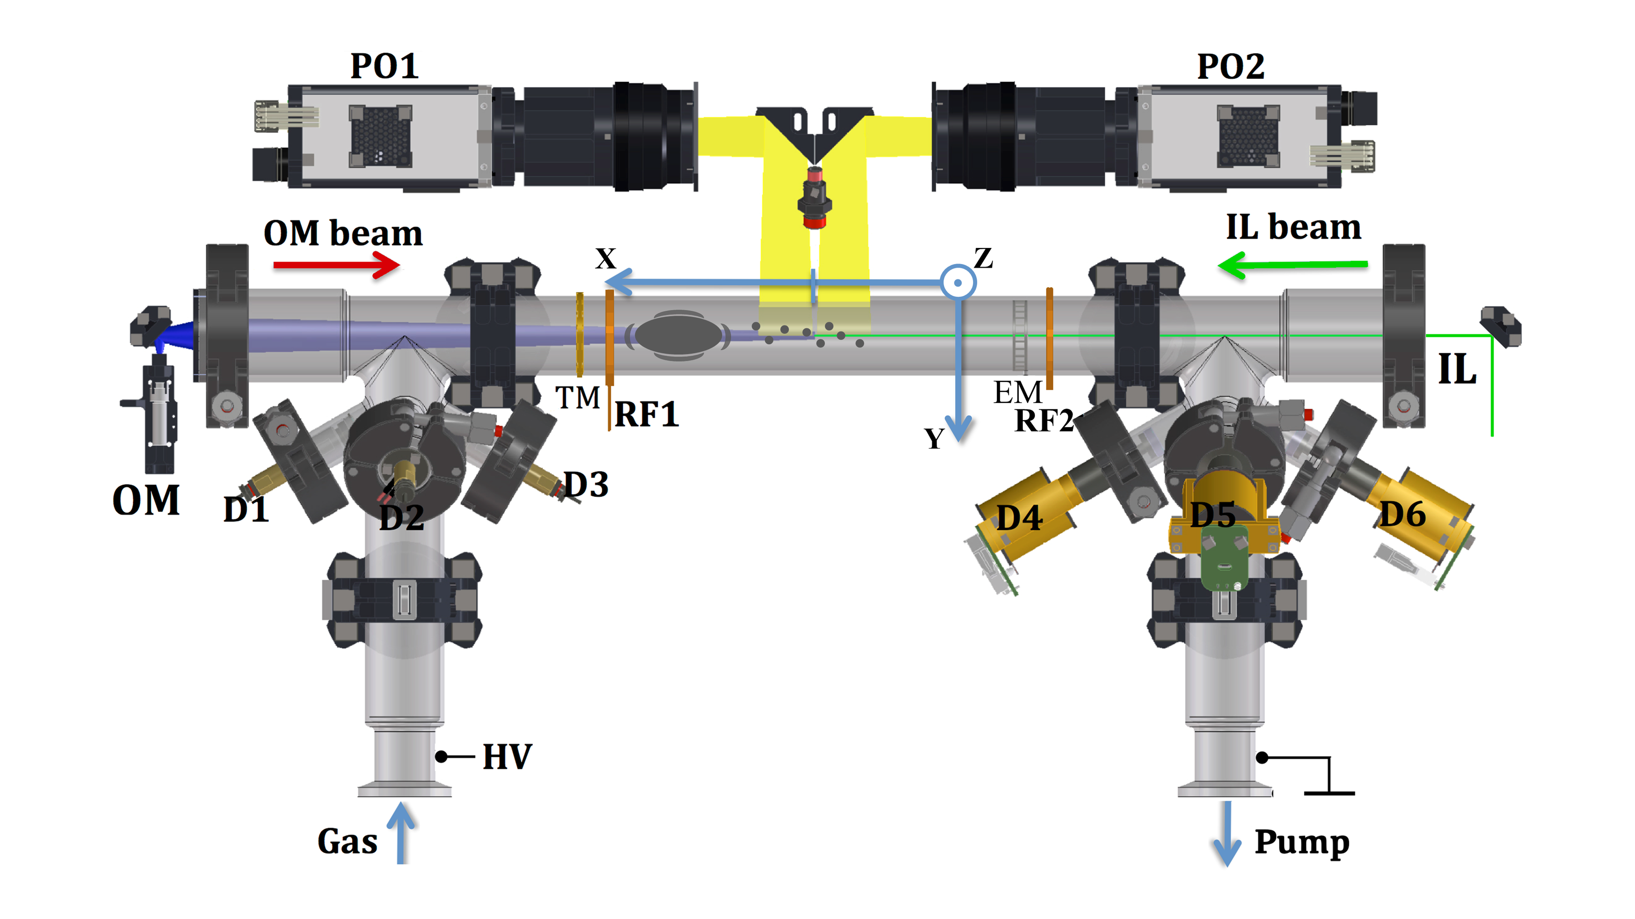
VM1
20Pa
VM2
120Pa
Neon
Argon

Slide 8
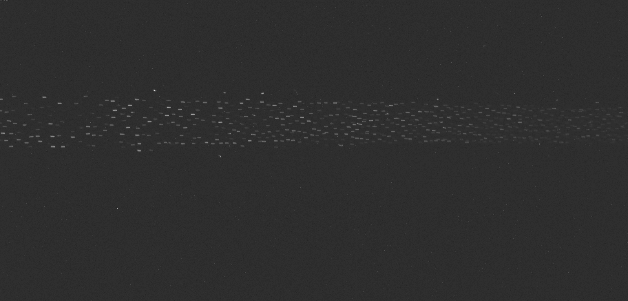

VM1
1mA
20Pa
VM2
1mA
120Pa
Neon
artificially reconstructed
Argon
digitally enhanced

Slide 9
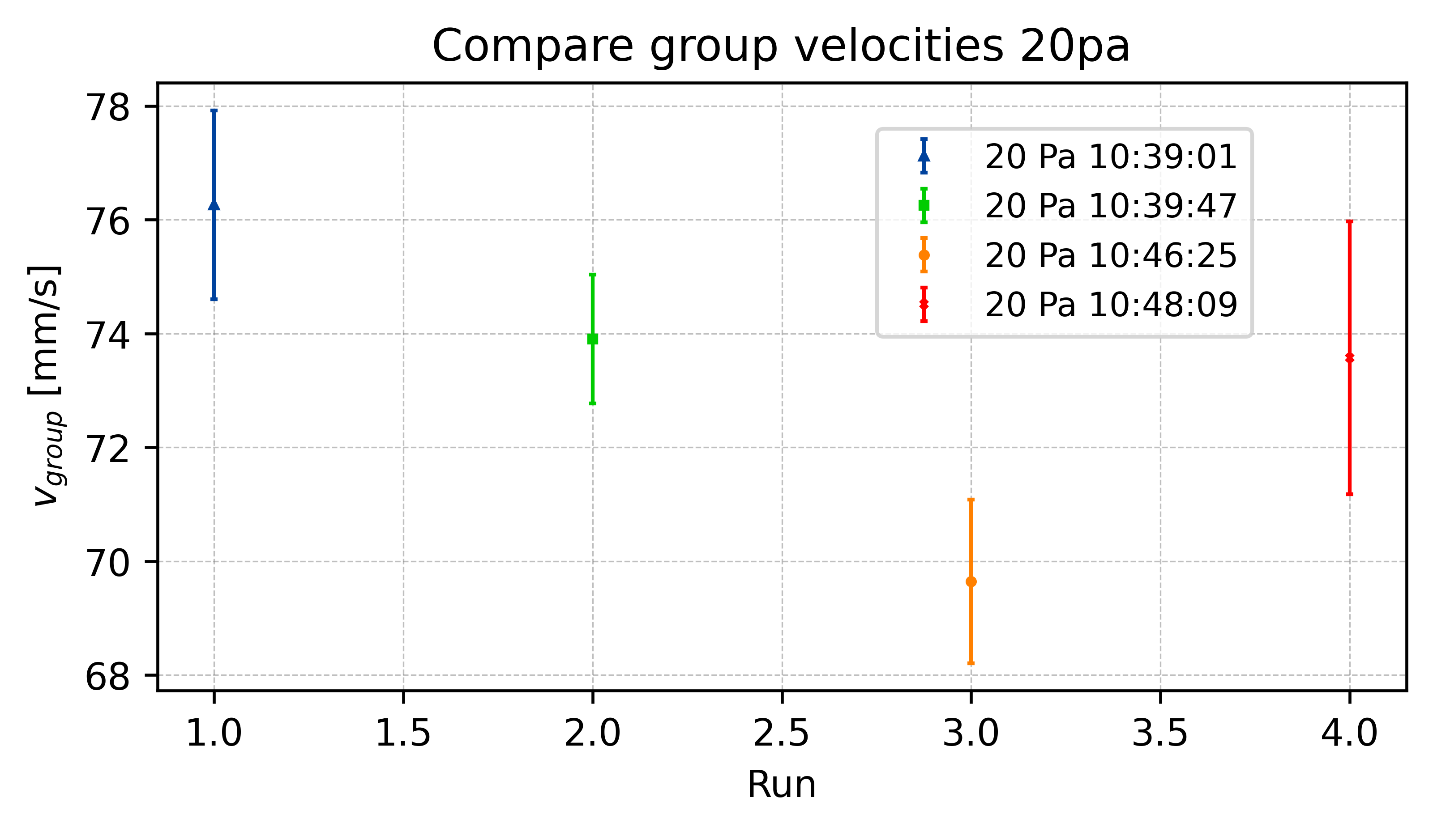
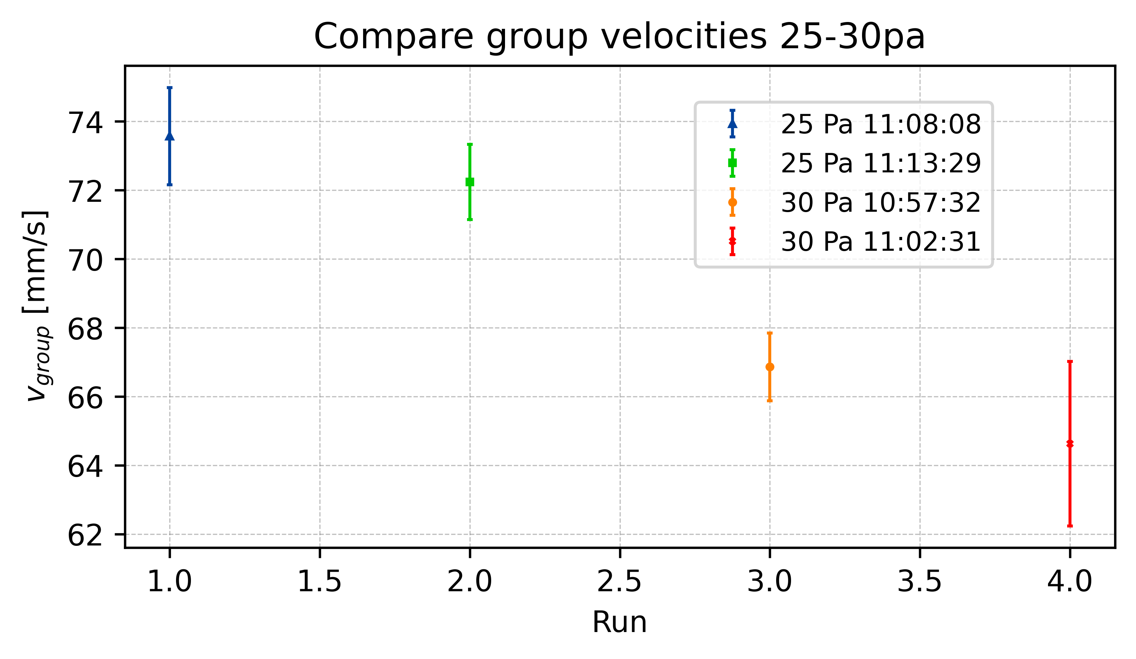
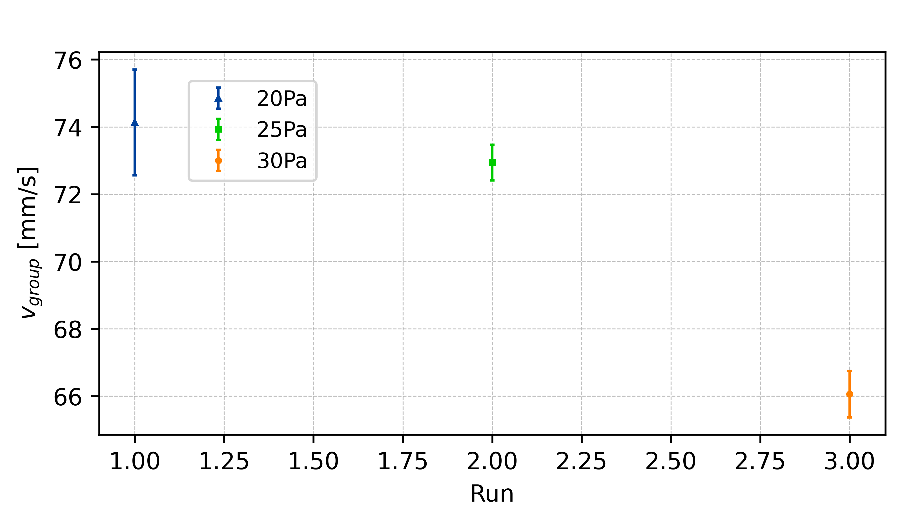
Group Velocity

Slide 10
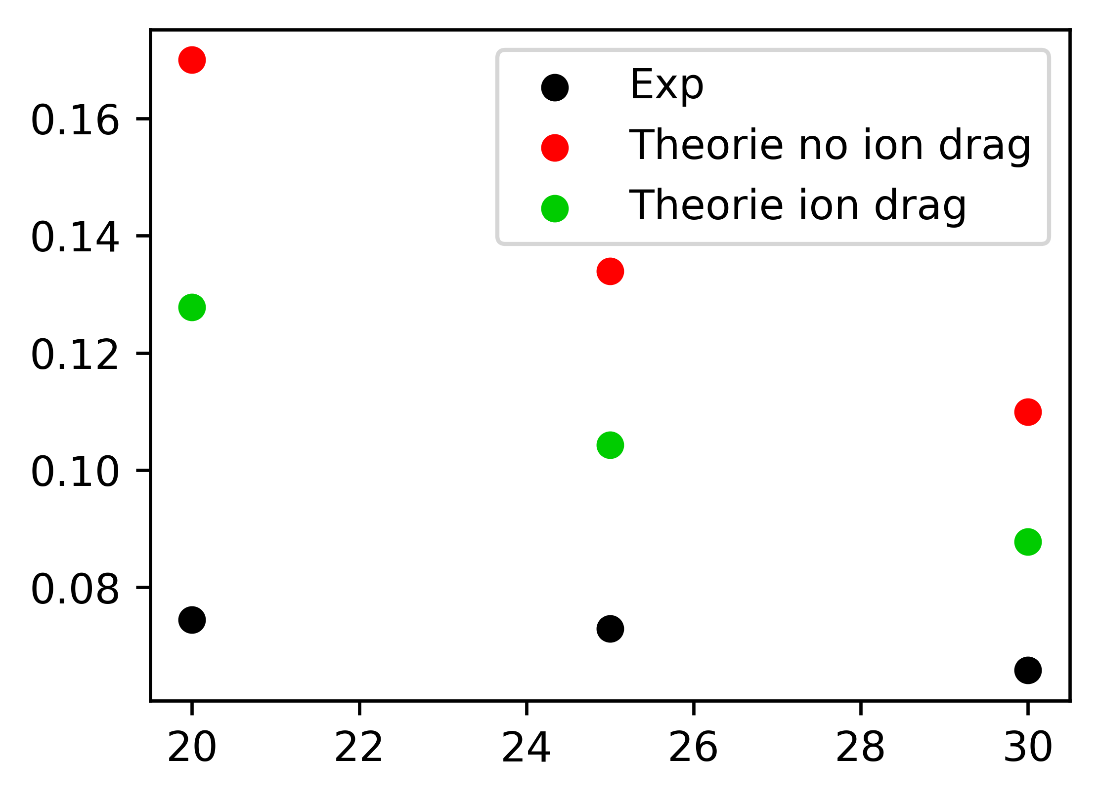
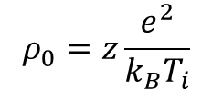
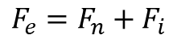
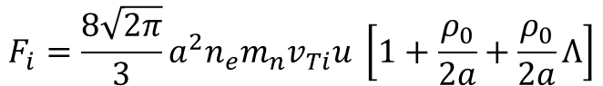
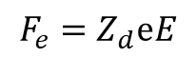
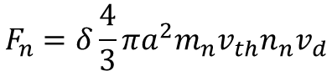
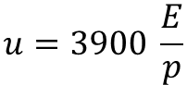
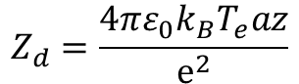
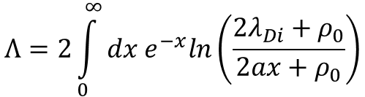
Theoretical Group Velocity
Khrapak et. al.
$$F_{e}=F_{n}+F_{i}$$
$$F_{e}=Z_{d}ⅇE$$
Z=0.345
$$F_{n}=δ\frac{4}{3}πa^{2}m_{n}v_{th}n_{n}v_{d}$$
$$F_{i}=\frac{8\sqrt{2π}}{3}a^{2}n_{e}m_{n}v_{Ti}u \left[1+\frac{ρ_{0}}{2a}+\frac{ρ_{0}}{2a}Λ\right]$$
$$ρ_{0}=z\frac{e^{2}}{k_{B}T_{i}}$$
$$Λ=2\int_{0}^{∞}{dx e^{−x}ln\left(\frac{2λ_{Di}+ρ_{0}}{2ax+ρ_{0}}\right)}$$
$$u=3900 \frac{E}{p}$$
$$Z_{d}=\frac{4πε_{0}k_{B}T_{e}az}{ⅇ^{2}}$$

Slide 11
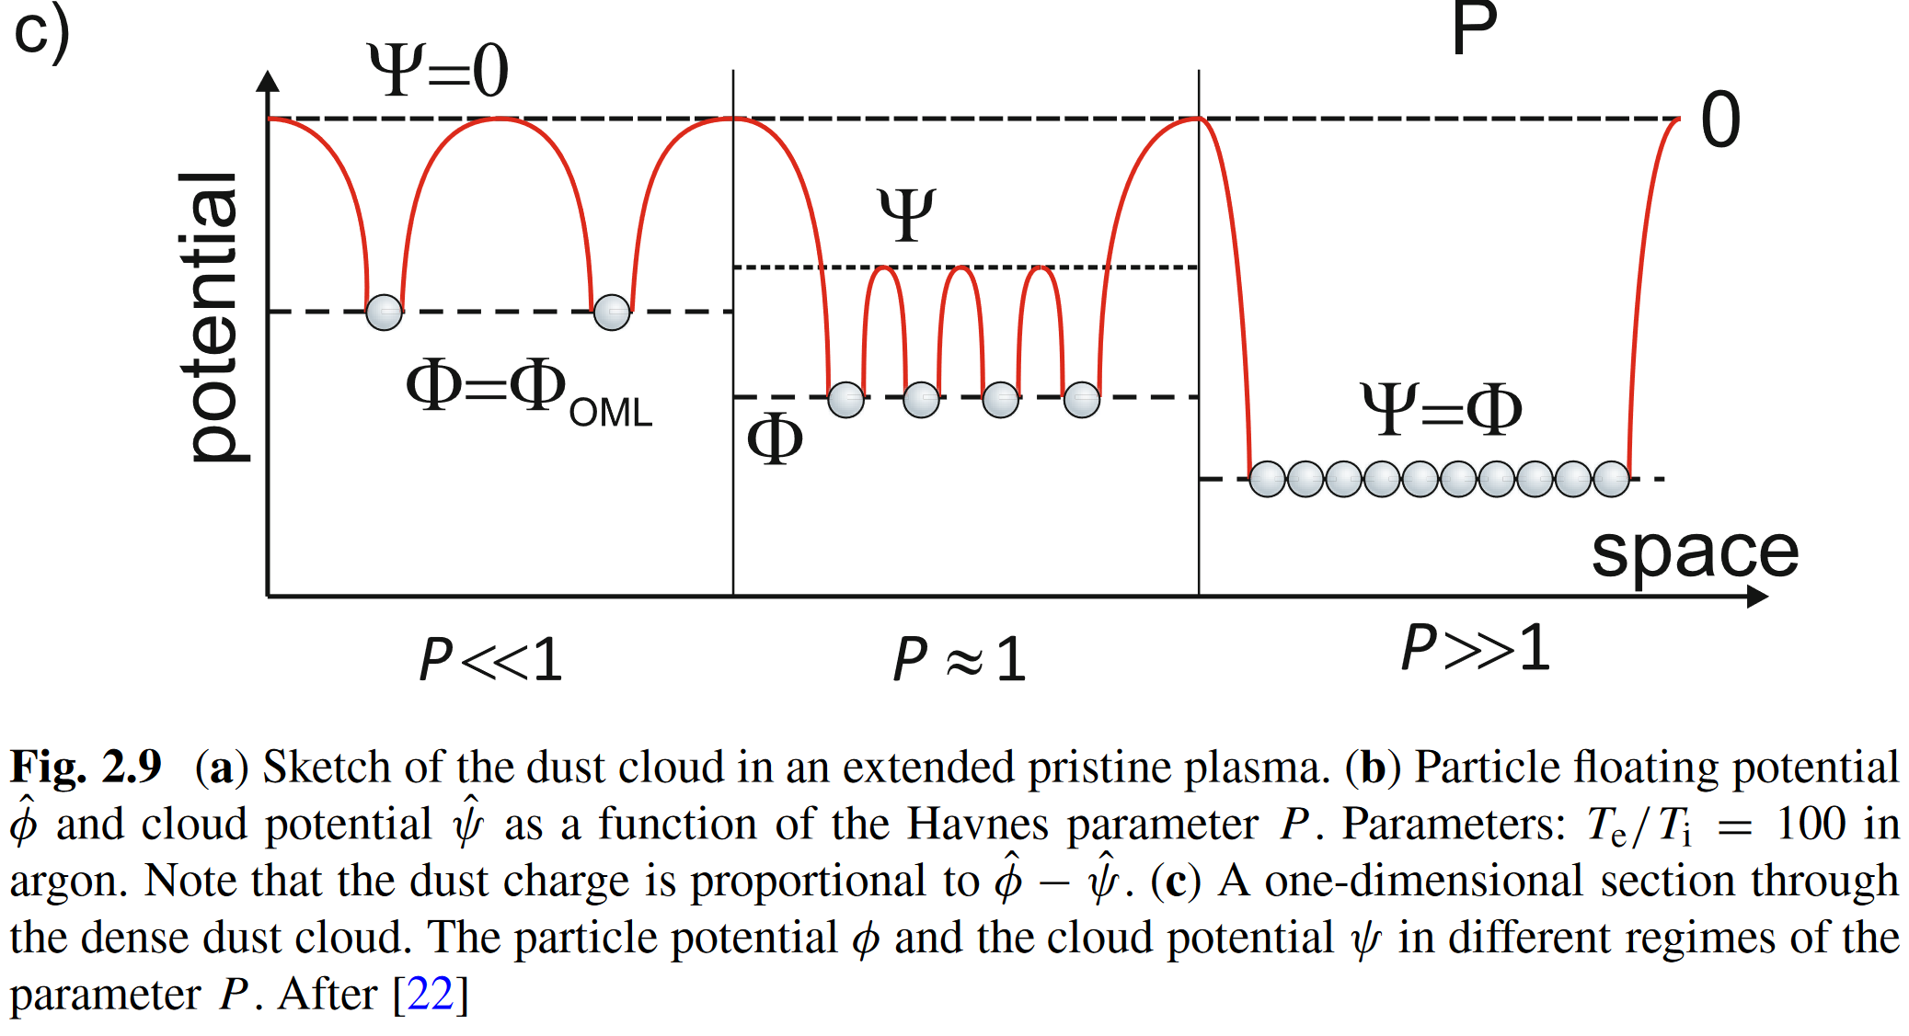
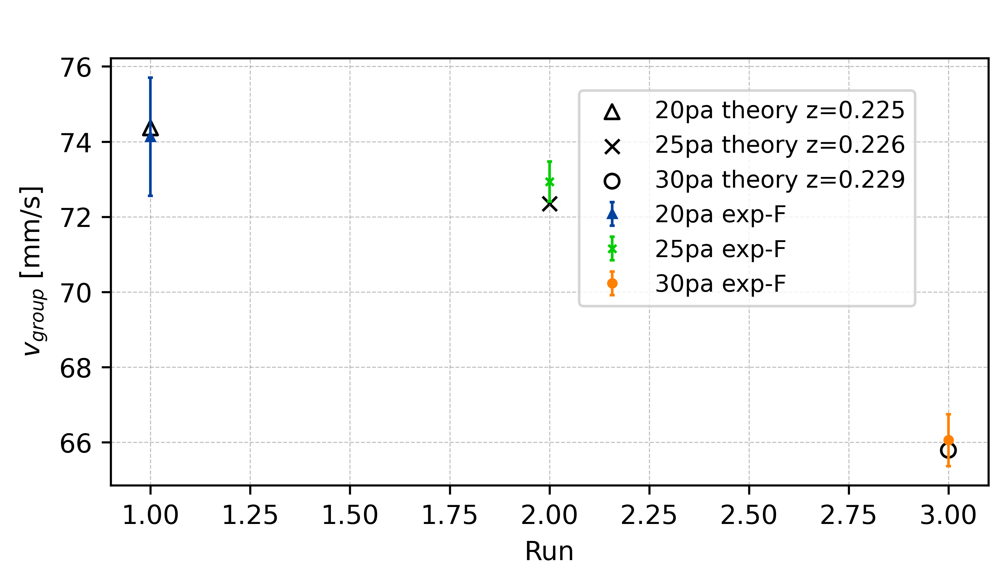
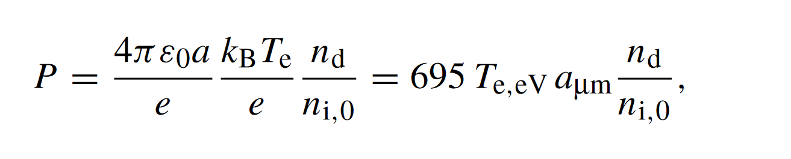
Charge Depletion – Havnes Parameter
[20Pa, 25Pa, 30Pa]
[2.047, 1.967, 1.899, 1.838]
New z from depletion theory

Slide 12
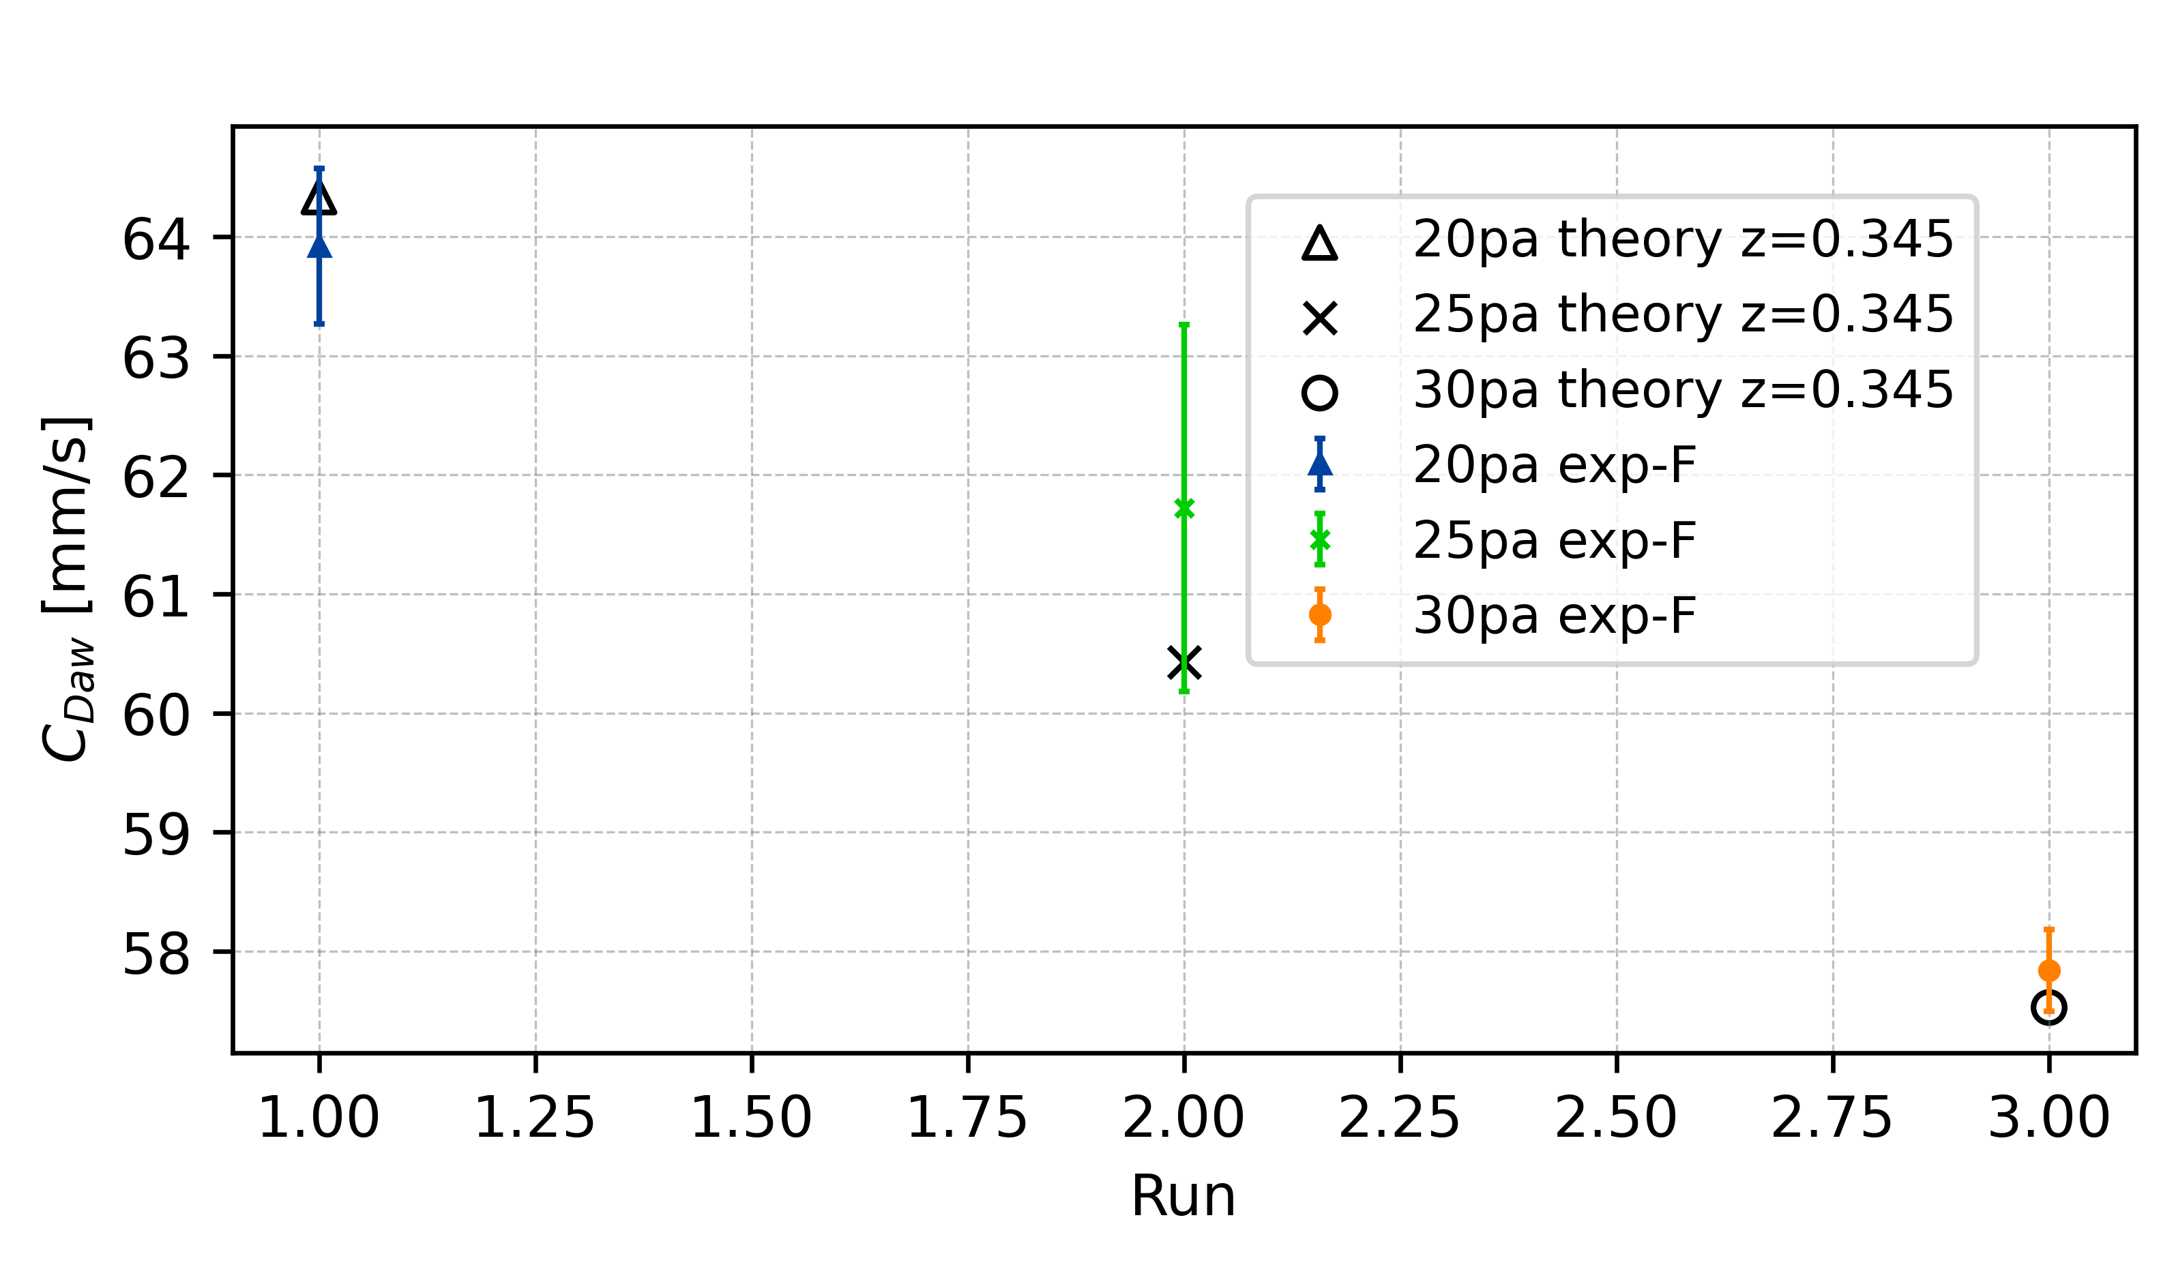
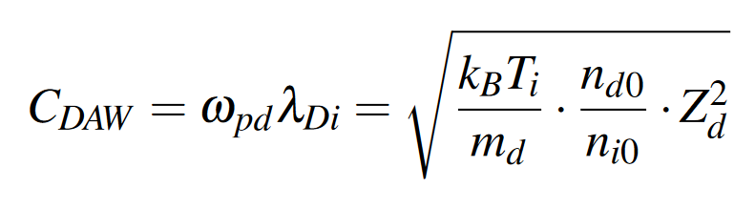
Dust-accoustic wave phase speed – C_{DAW}
Charge depletion is not playing a role in wave propagation
Charge reduction of individual particle is trigger effect of collective wave phenomena

Slide 13
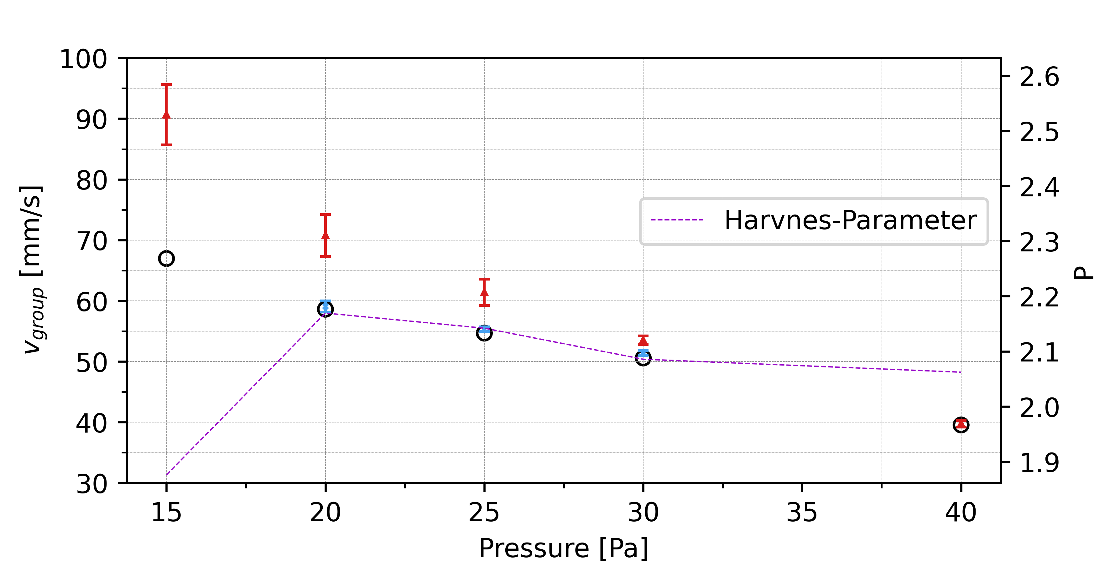
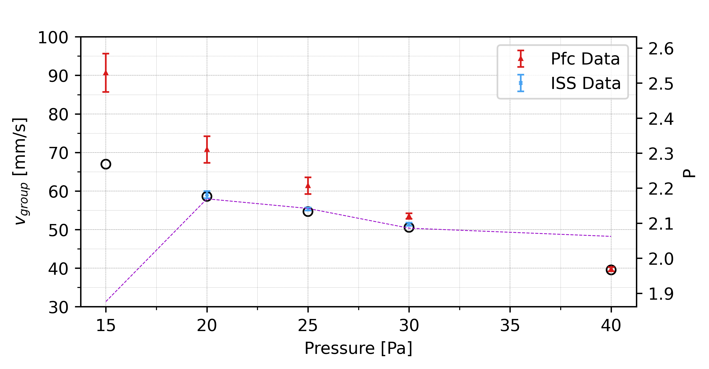
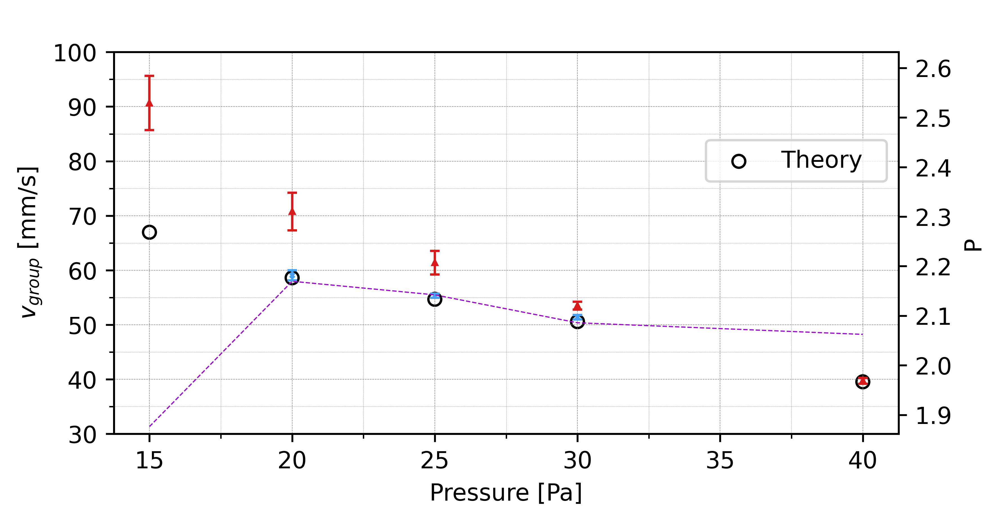

Slide 14
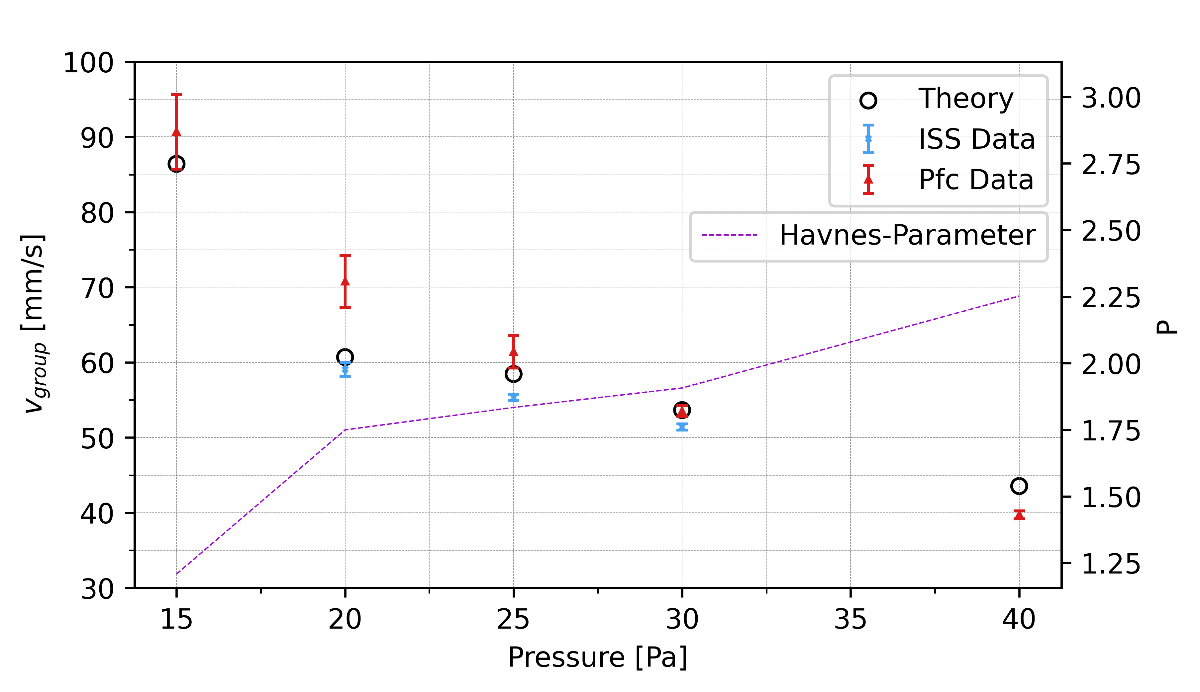
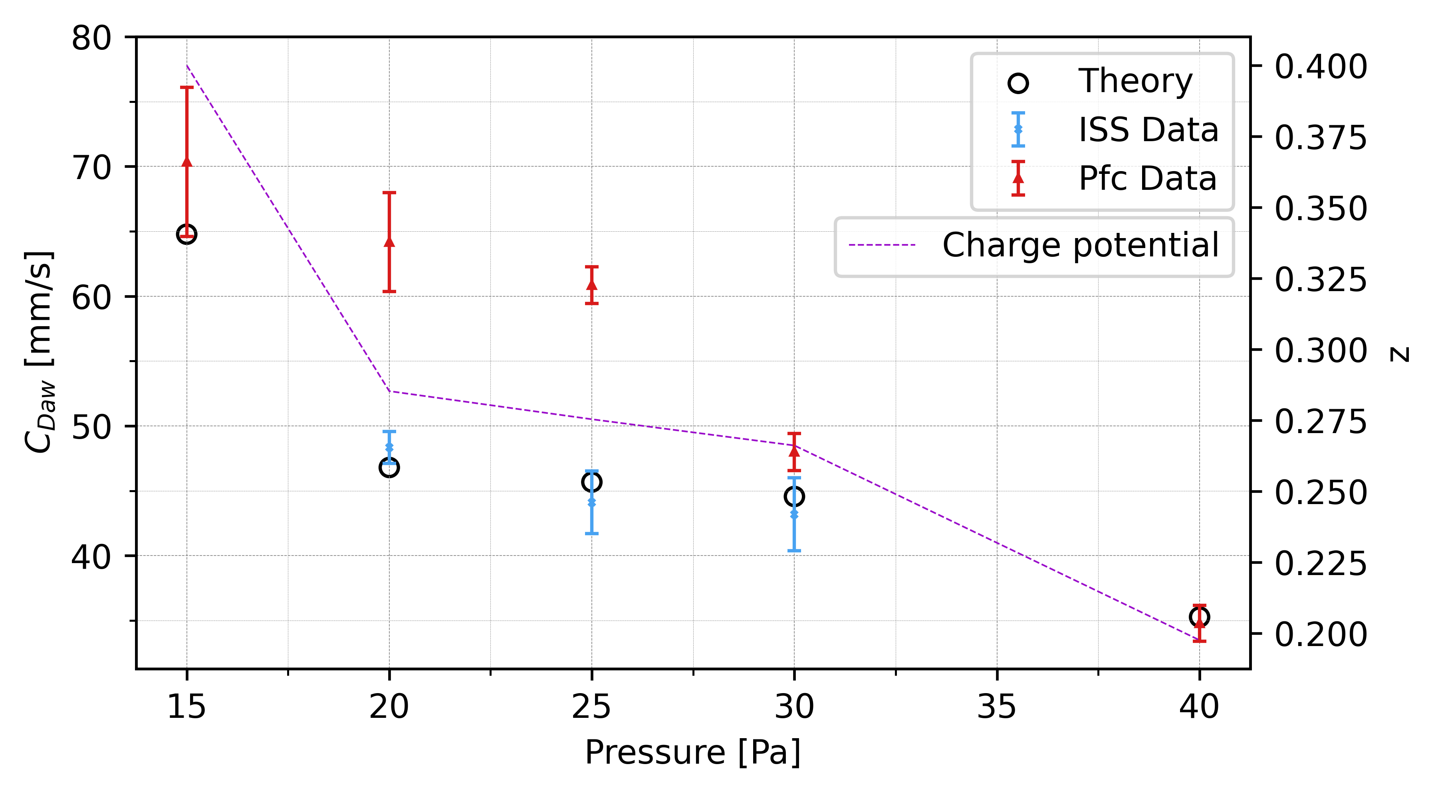

Slide 15
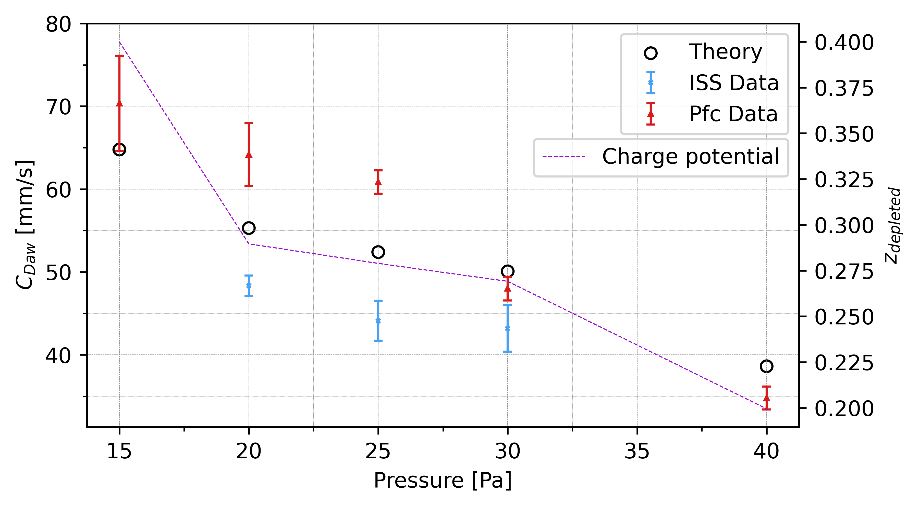

Slide 16
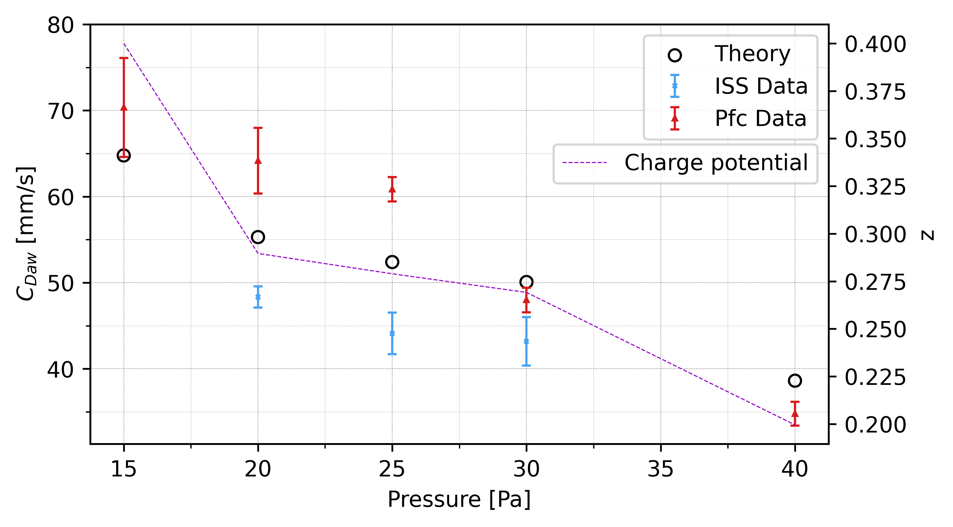
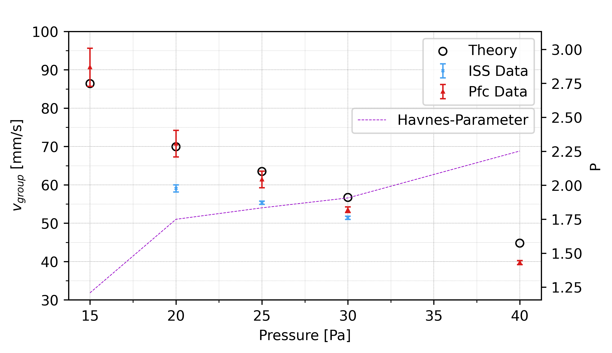

Slide 17
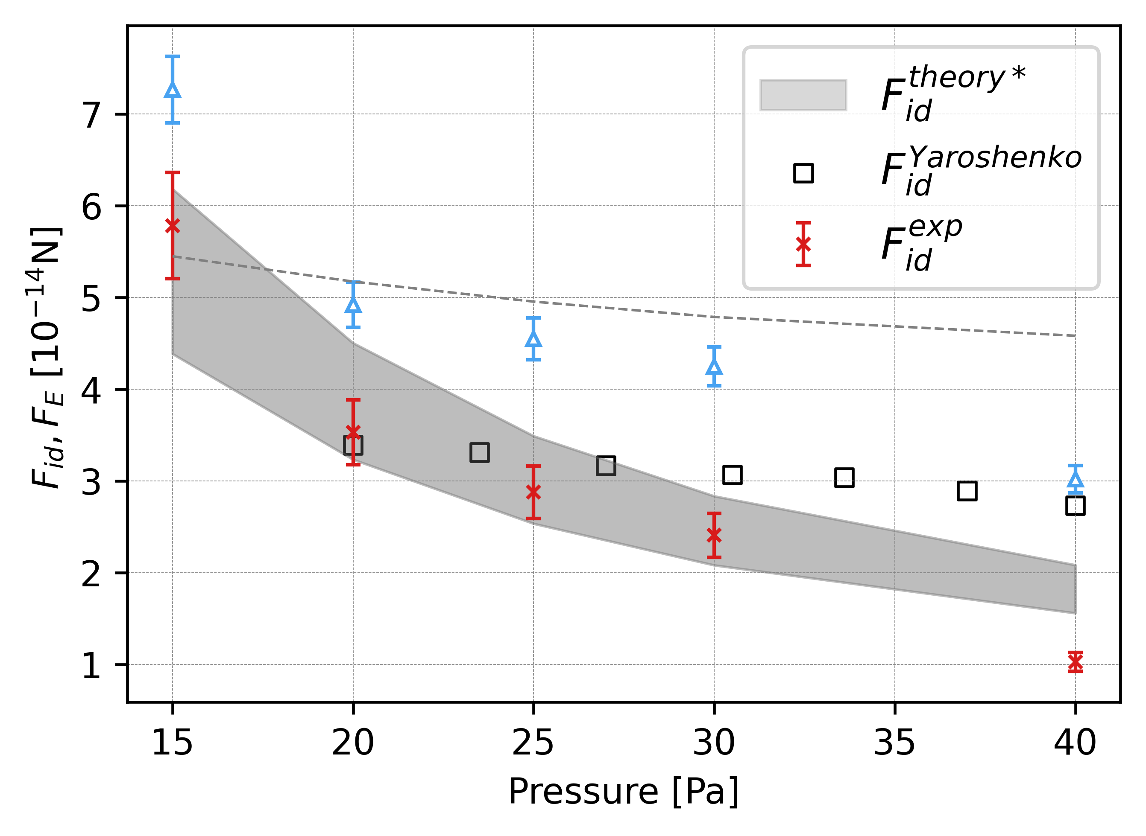
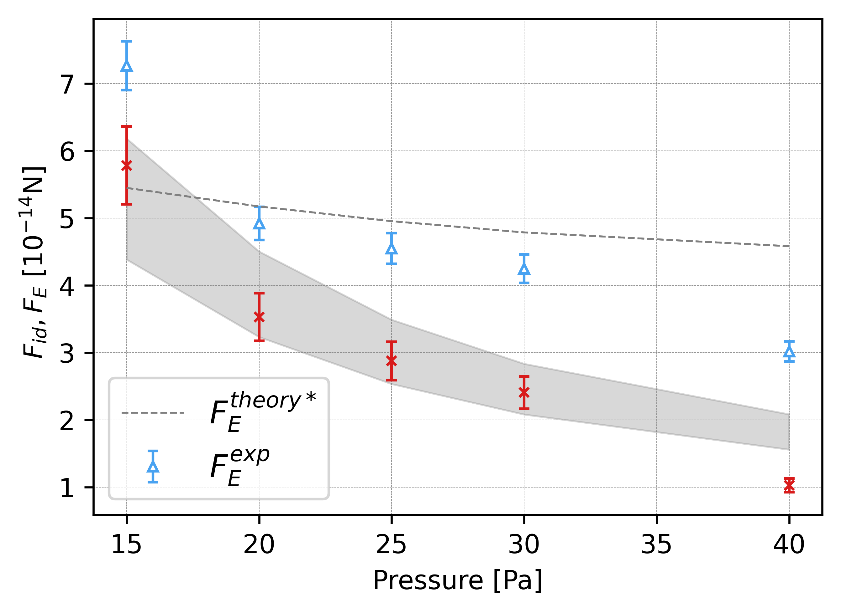

Slide 18
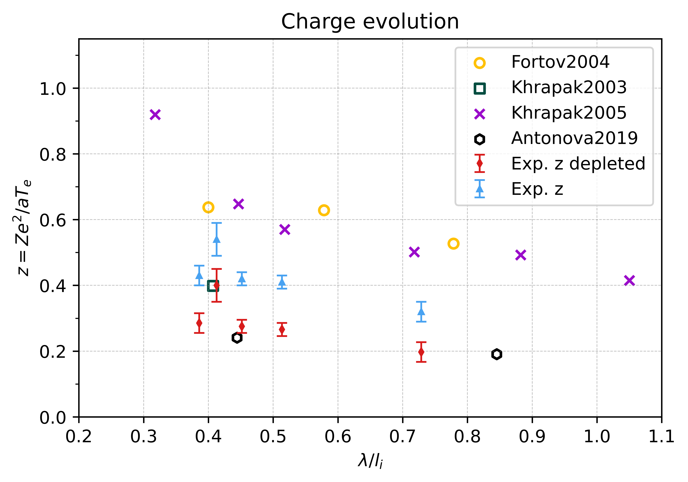
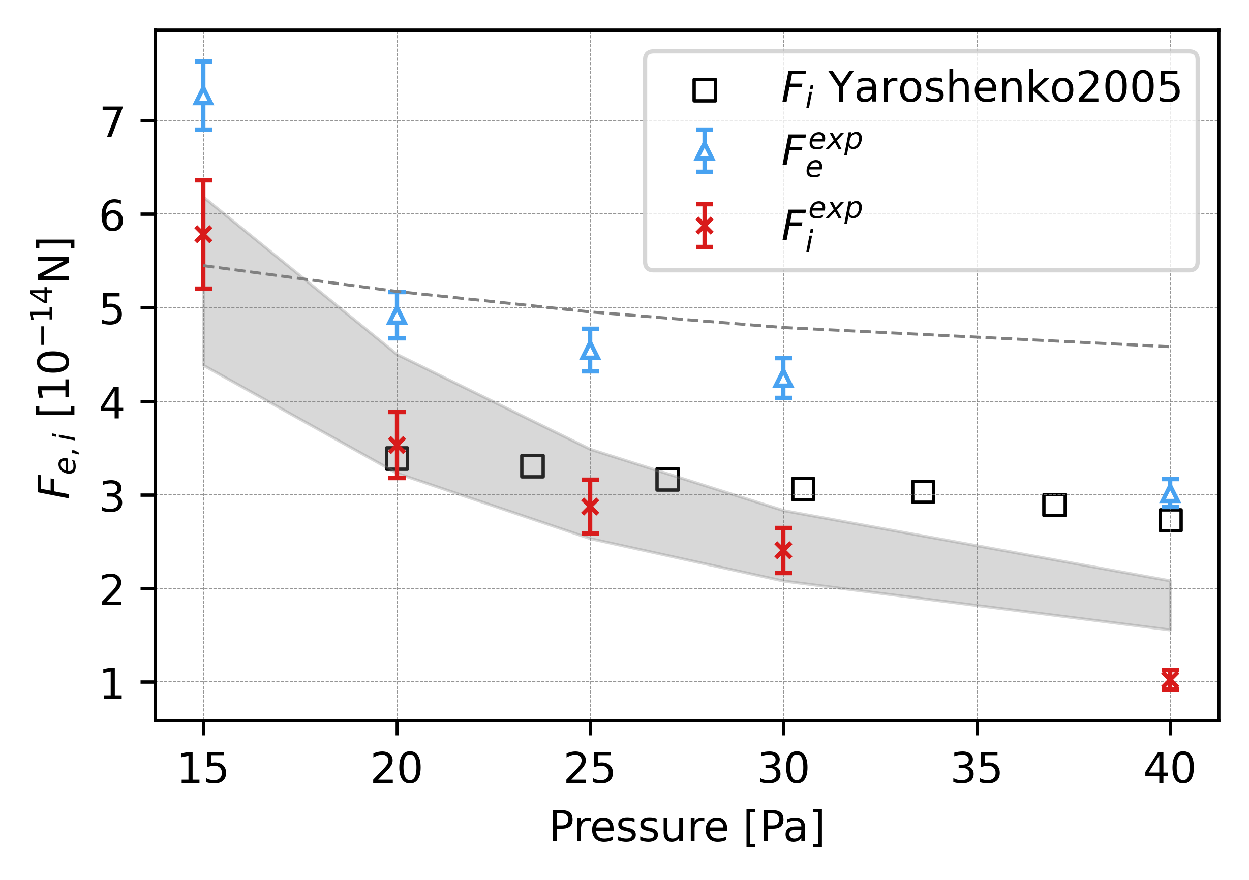

Slide 19
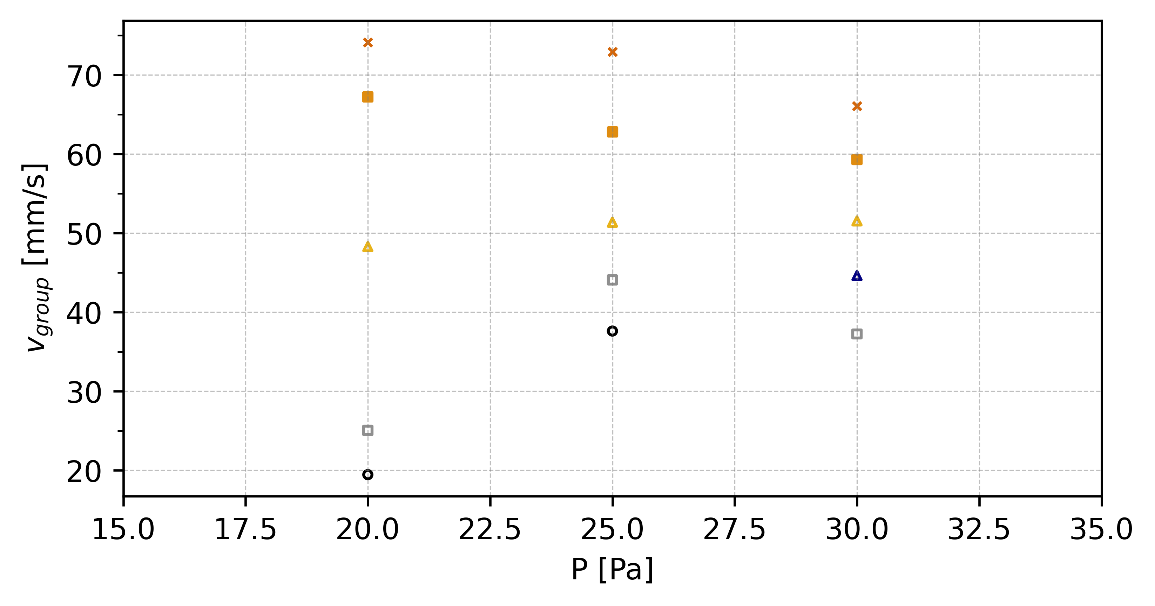
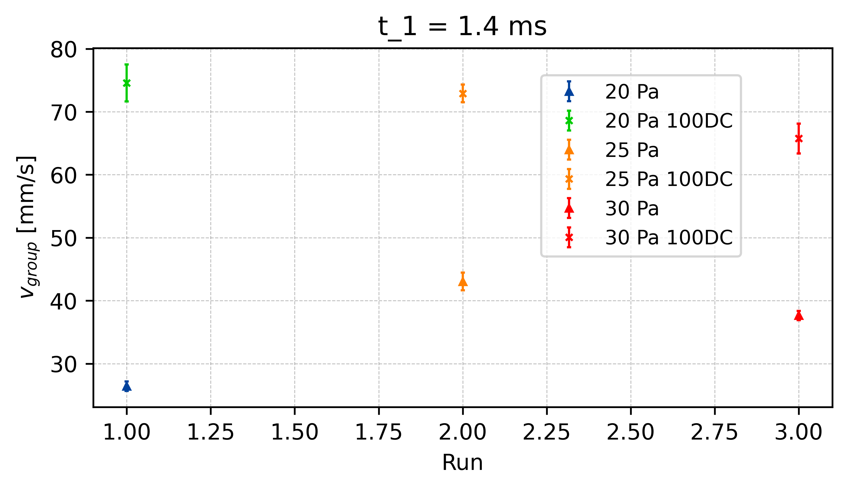
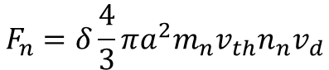
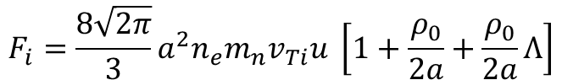
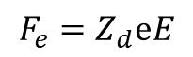
Reduction of Electric Field - v_{group}
t = 1.3ms
E_{effectiv} = 30%
100%
t = 1.4ms
E_{effectiv} = 40%
t1.4
80%
t = 1.5ms
E_{effectiv} = 50%
60%
t1.4
∆v_{25_t1.4}
t1.4
50%
∆v_{20_t1.4}
∆v_{30_t1.4}
$$F_{e}=Z_{d}ⅇE$$
40%
x E_eff
30%
$$F_{n}=δ\frac{4}{3}πa^{2}m_{n}v_{th}n_{n}v_{d}$$
$$F_{i}=\frac{8\sqrt{2π}}{3}a^{2}n_{e}m_{n}v_{Ti}u \left[1+\frac{ρ_{0}}{2a}+\frac{ρ_{0}}{2a}Λ\right]$$
x E_eff
x E_eff
Vergleiche: V_g vs P und V_g vs E

Slide 20
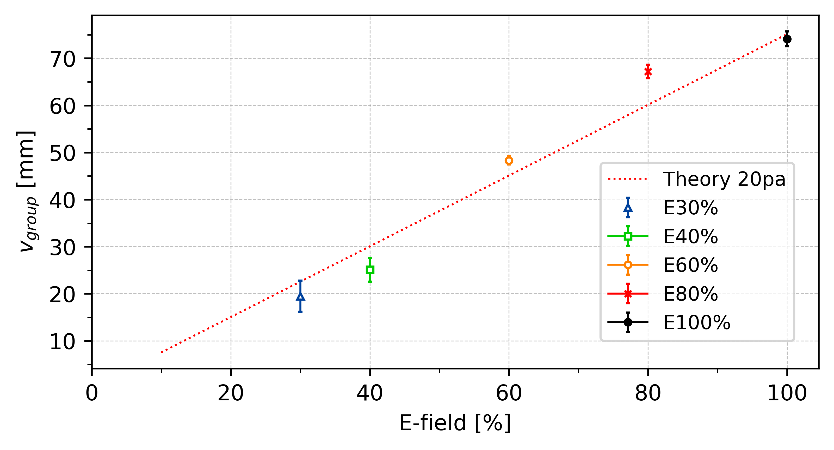
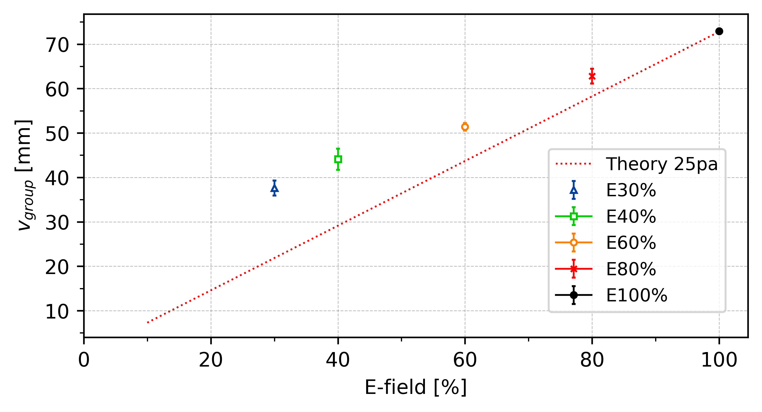
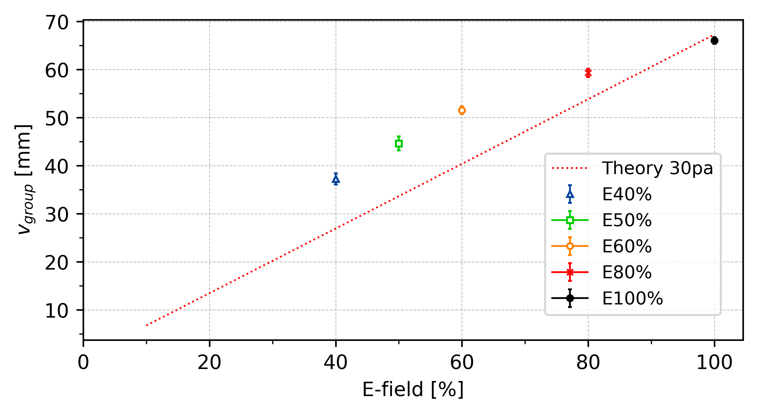




Reduction of Electric Field - v_{group}
. . .
t = 1.3ms
E_{eff} = 30%
$$F_{e,eff}=F_{n}+F_{i}$$
t = 1.4ms
E_{eff} = 40%
$$F_{e,eff}=Z_{d}ⅇE_{eff}$$
t = 1.5ms
E_{eff} = 50%
. . .
$$F_{i}=\frac{8\sqrt{2π}}{3}a^{2}n_{e}m_{n}v_{Ti}u \left[1+\frac{ρ_{0}}{2a}+\frac{ρ_{0}}{2a}Λ\right]$$
$$u=3900 \frac{E_{eff}}{p}$$
Modified frost formular?

Slide 21




Slide 22


Reduction of Electric Field - C_{DAW}
t = 1.4ms
E_{effectiv} = 40%

Slide 23



Reduction of Electric Field - C_{DAW}
*E_eff[%]
Or ?
*E_eff[%]

Slide 24




Slide 25



Slide 26



Slide 27



Slide 28



Slide 29

p(x)

Slide 30



Slide 31

Critical Electric Field - C_{DAW}
Pressure | C_Forward | E-field Forward | E-crit
20
20
25
25
30
30

Slide 32
Appendix

Slide 33


Polarity Difference
Average
∆c_20 = 11.0 mm/s ~ 14.5%
∆c_25 = 13.5 mm/s ~ 17.8%
∆c_30 = 7.8 mm/s ~ 11.9%
∆c_20
∆c_25
∆c_30

Slide 34


∆c_30 = 8.5 mm/s ~ 17.0%

Slide 35




Slide 36


-
∆c_25
∆c_30
∆c_20 = 4.5 mm/s ~ 14.5%
∆c_25 = 7.5 mm/s ~ 15.5%
∆c_30 = 6.9 mm/s ~ 15.5%
∆c_20

Slide 37

331 = 3,9058 mm
10 f = 0,16 sec
24,3 mm/s

